Slide 1
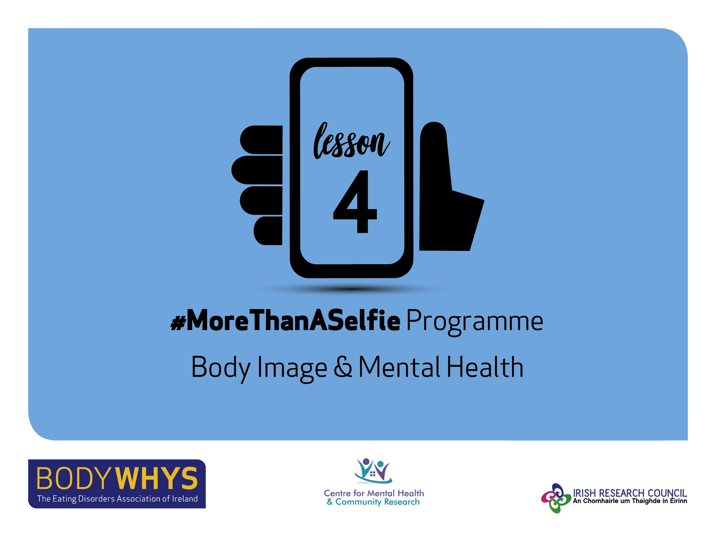
#MoreThanASelfie Programme © Bodywhys 2020
www.bodywhys.ie

Slide 2
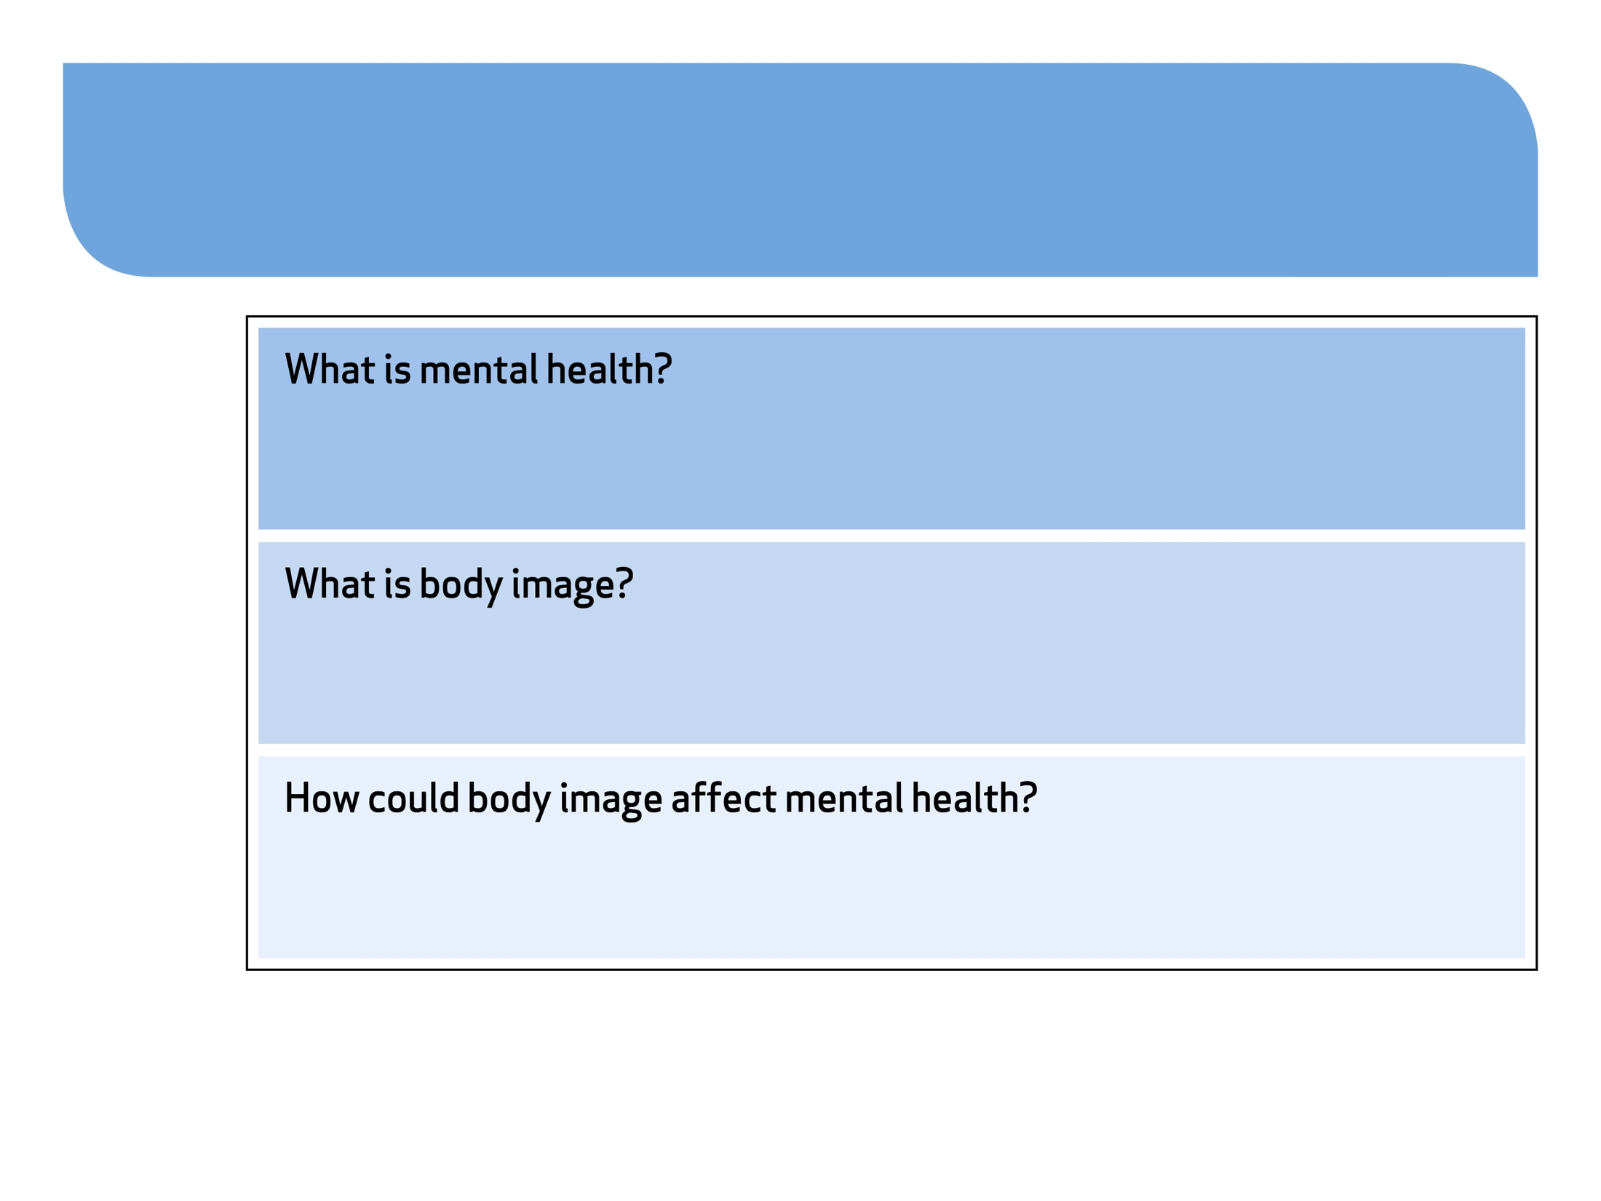
Body Image & Mental Health
#MoreThanASelfie Programme © Bodywhys 2020
www.bodywhys.ie

Slide 3
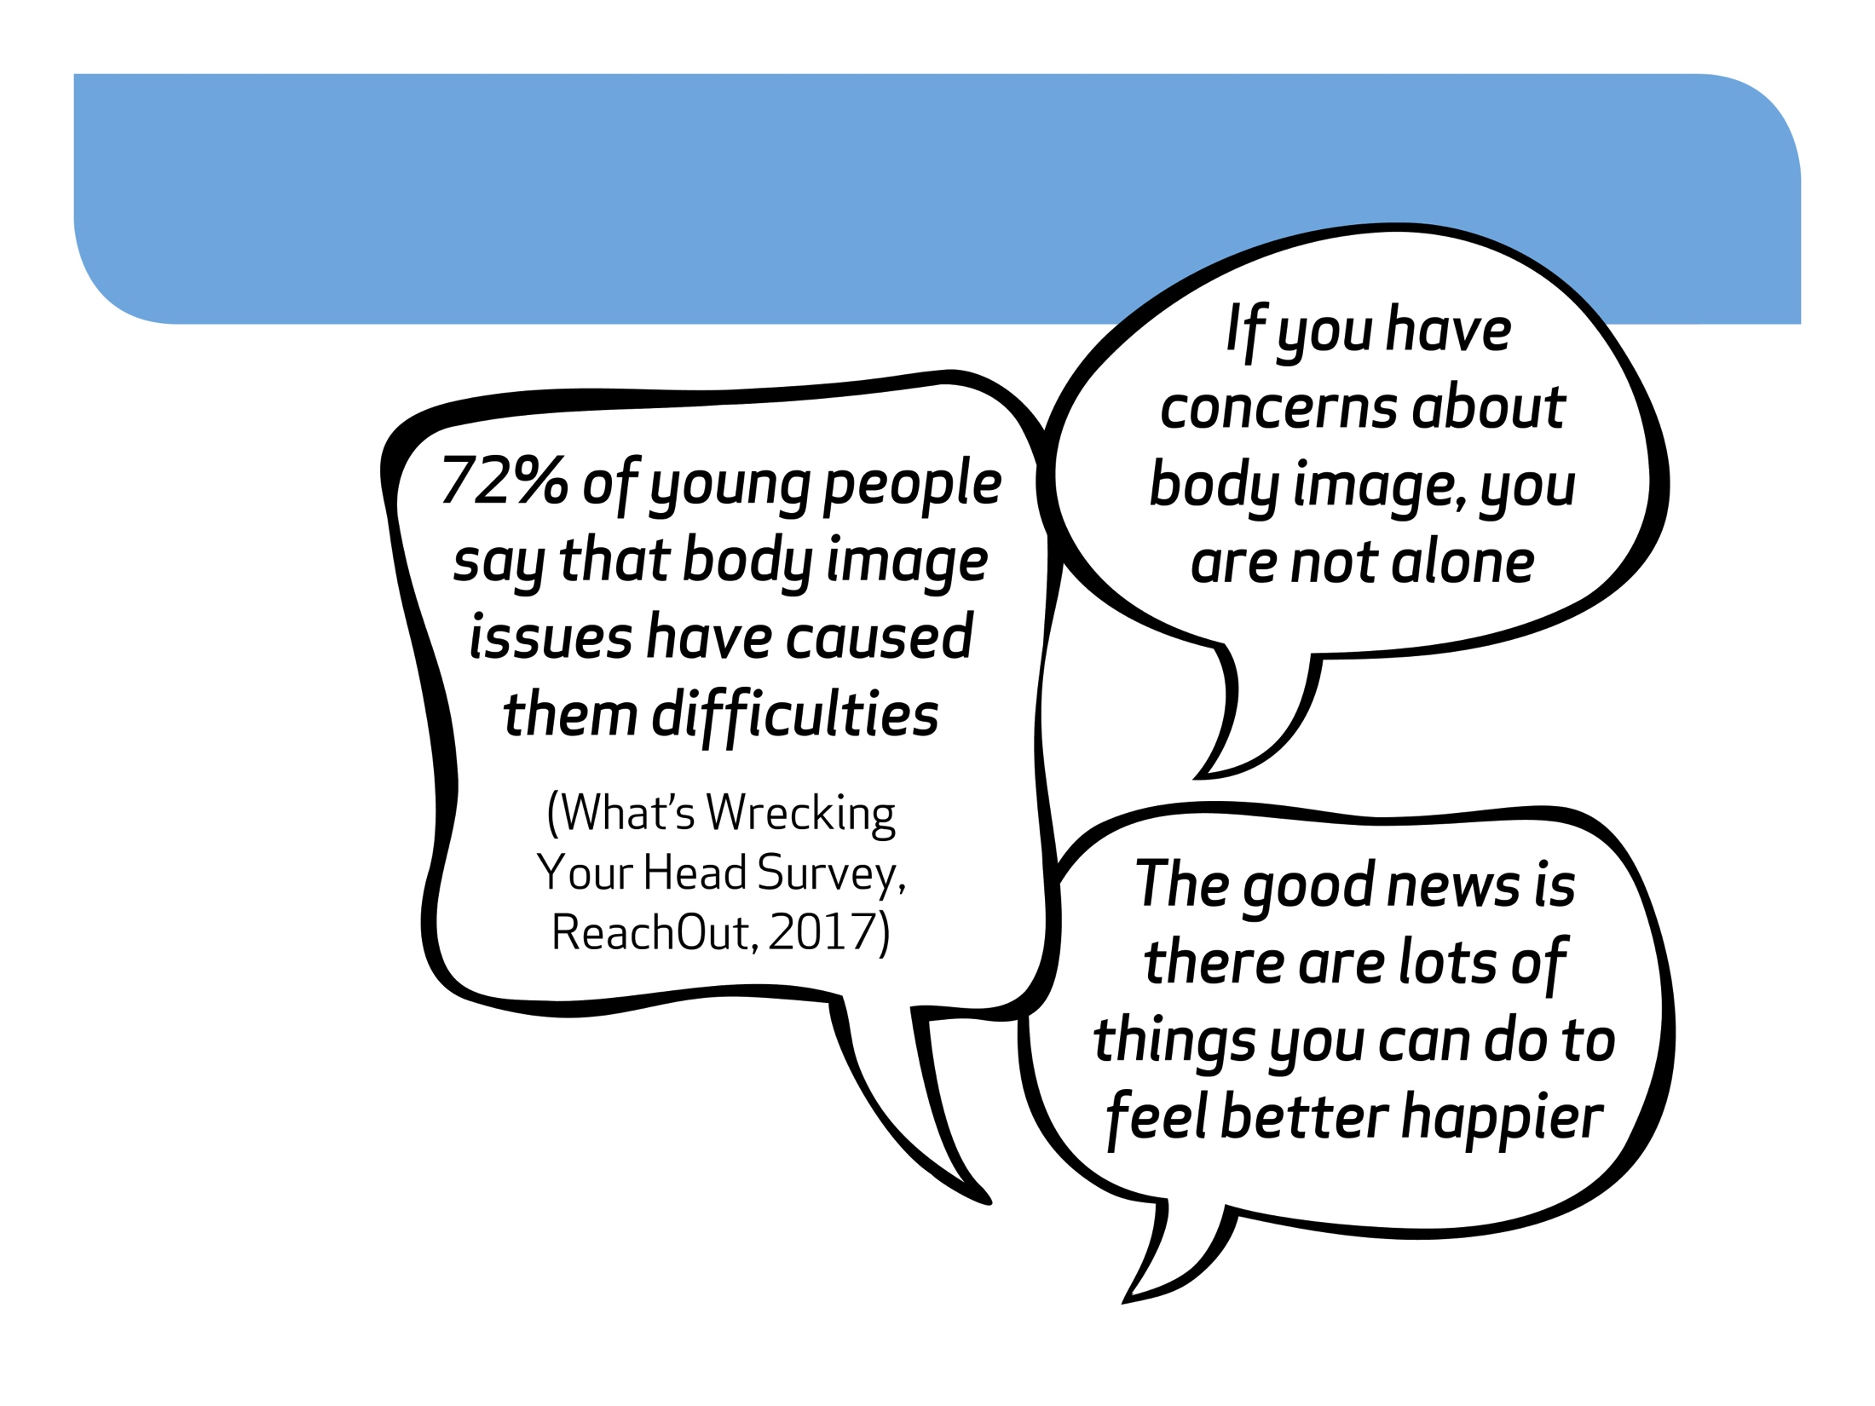
Body Image & Young People
#MoreThanASelfie Programme © Bodywhys 2020
www.bodywhys.ie

Slide 4
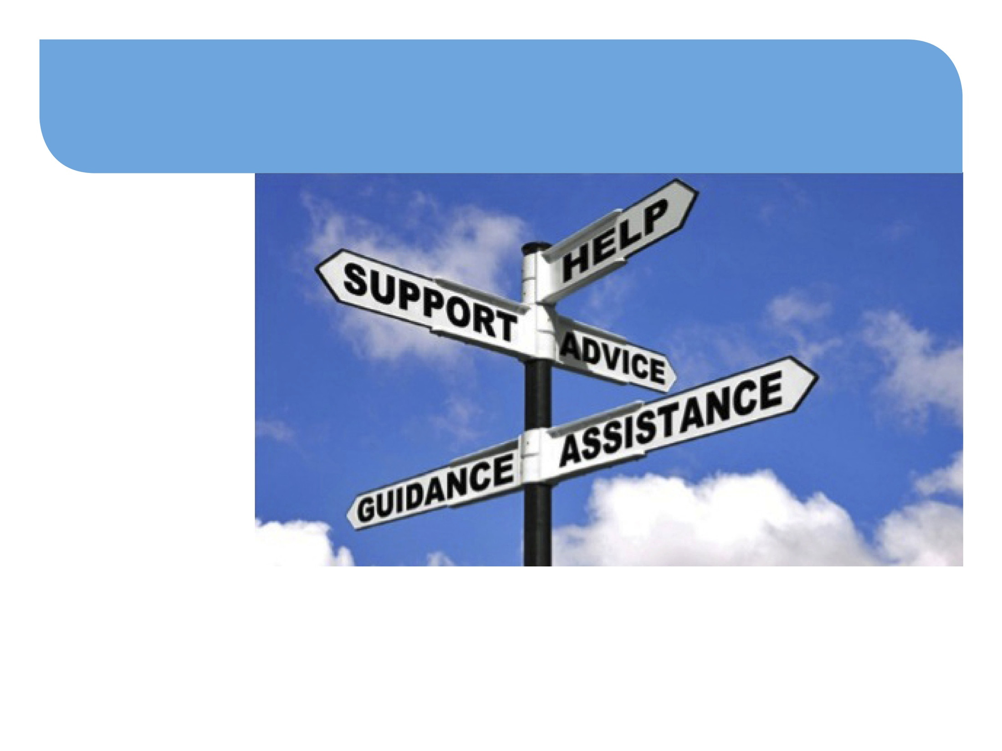
Focus: Understanding Eating Disorders
#MoreThanASelfie Programme © Bodywhys 2020
www.bodywhys.ie

Slide 5
Eating Disorders Affect Males & Females
According to UK figures from the NHS:
The number of adult men being admitted to hospital with an eating disorder has risen by 70% over the past six years (from 2010 – 2016).
Source: The Guardian, 31st July 2017
#MoreThanASelfie Programme © Bodywhys 2020
www.bodywhys.ie

Slide 6
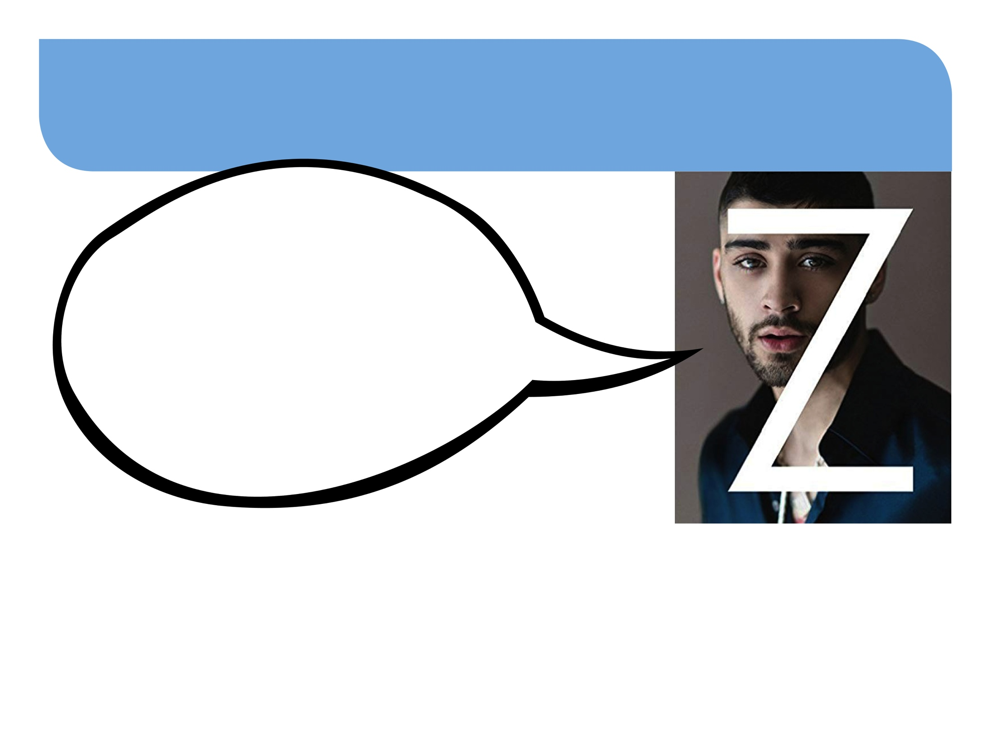
Zayn Malik opens up about his eating disorder in his autobiography ‘Zayn’
“They didn’t seem to expect it from a guy, but they expect it from a female, which to me is crazy. We’re all human. People are often afraid to admit difficulties, but I don’t believe that there should be a struggle with anything that’s the truth.”
Up to 25% of people with Anorexia or Bulimia are male
Binge eating disorder affects males and females equally (50/50)
Binge eating disorder is the most common type of eating disorder
#MoreThanASelfie Programme © Bodywhys 2020
www.bodywhys.ie

Slide 7
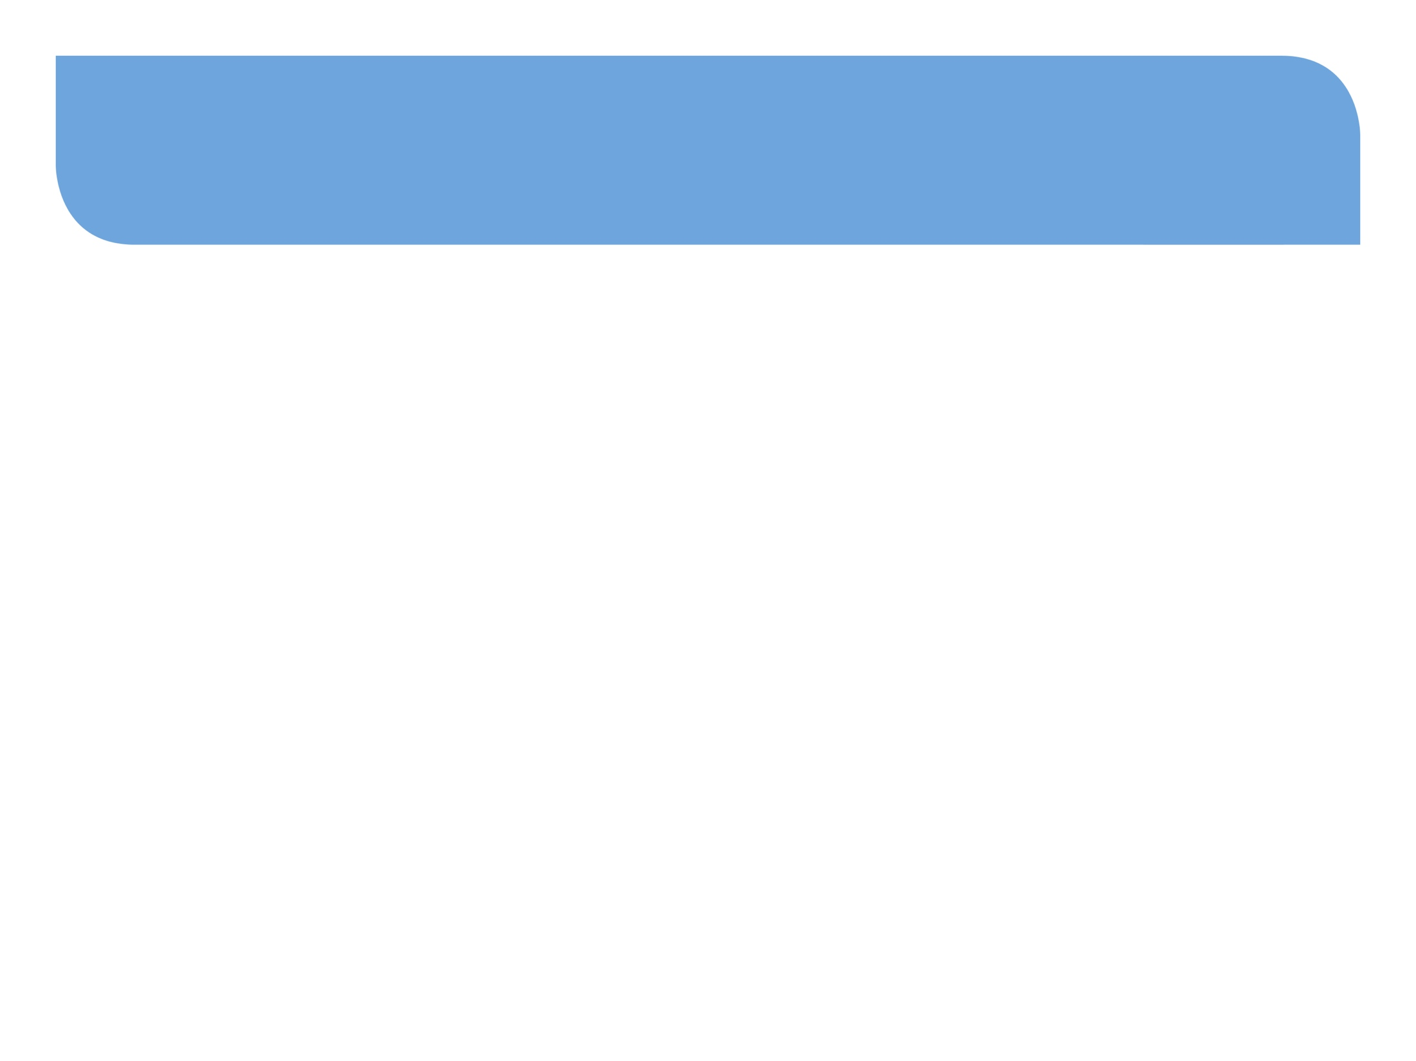
Eating Disorders – What do you know?
Can you name the different types of eating disorders?
(Clue: there are 3 main types)
#MoreThanASelfie Programme © Bodywhys 2020
www.bodywhys.ie

Slide 8
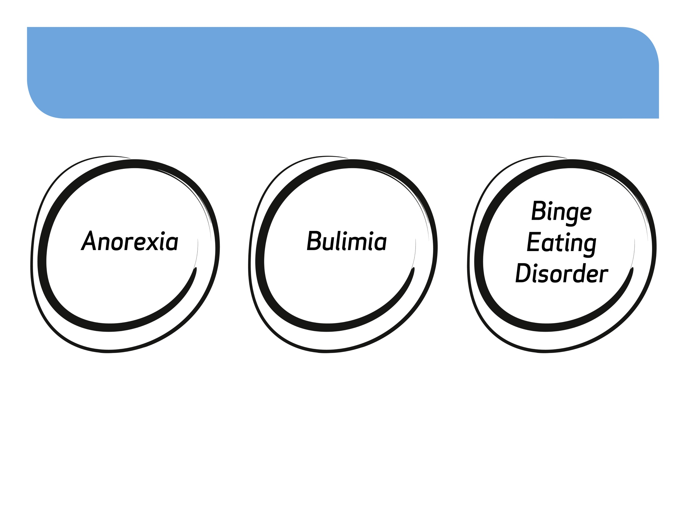
What do you know about each of these eating disorders?
#MoreThanASelfie Programme © Bodywhys 2020
www.bodywhys.ie

Slide 9
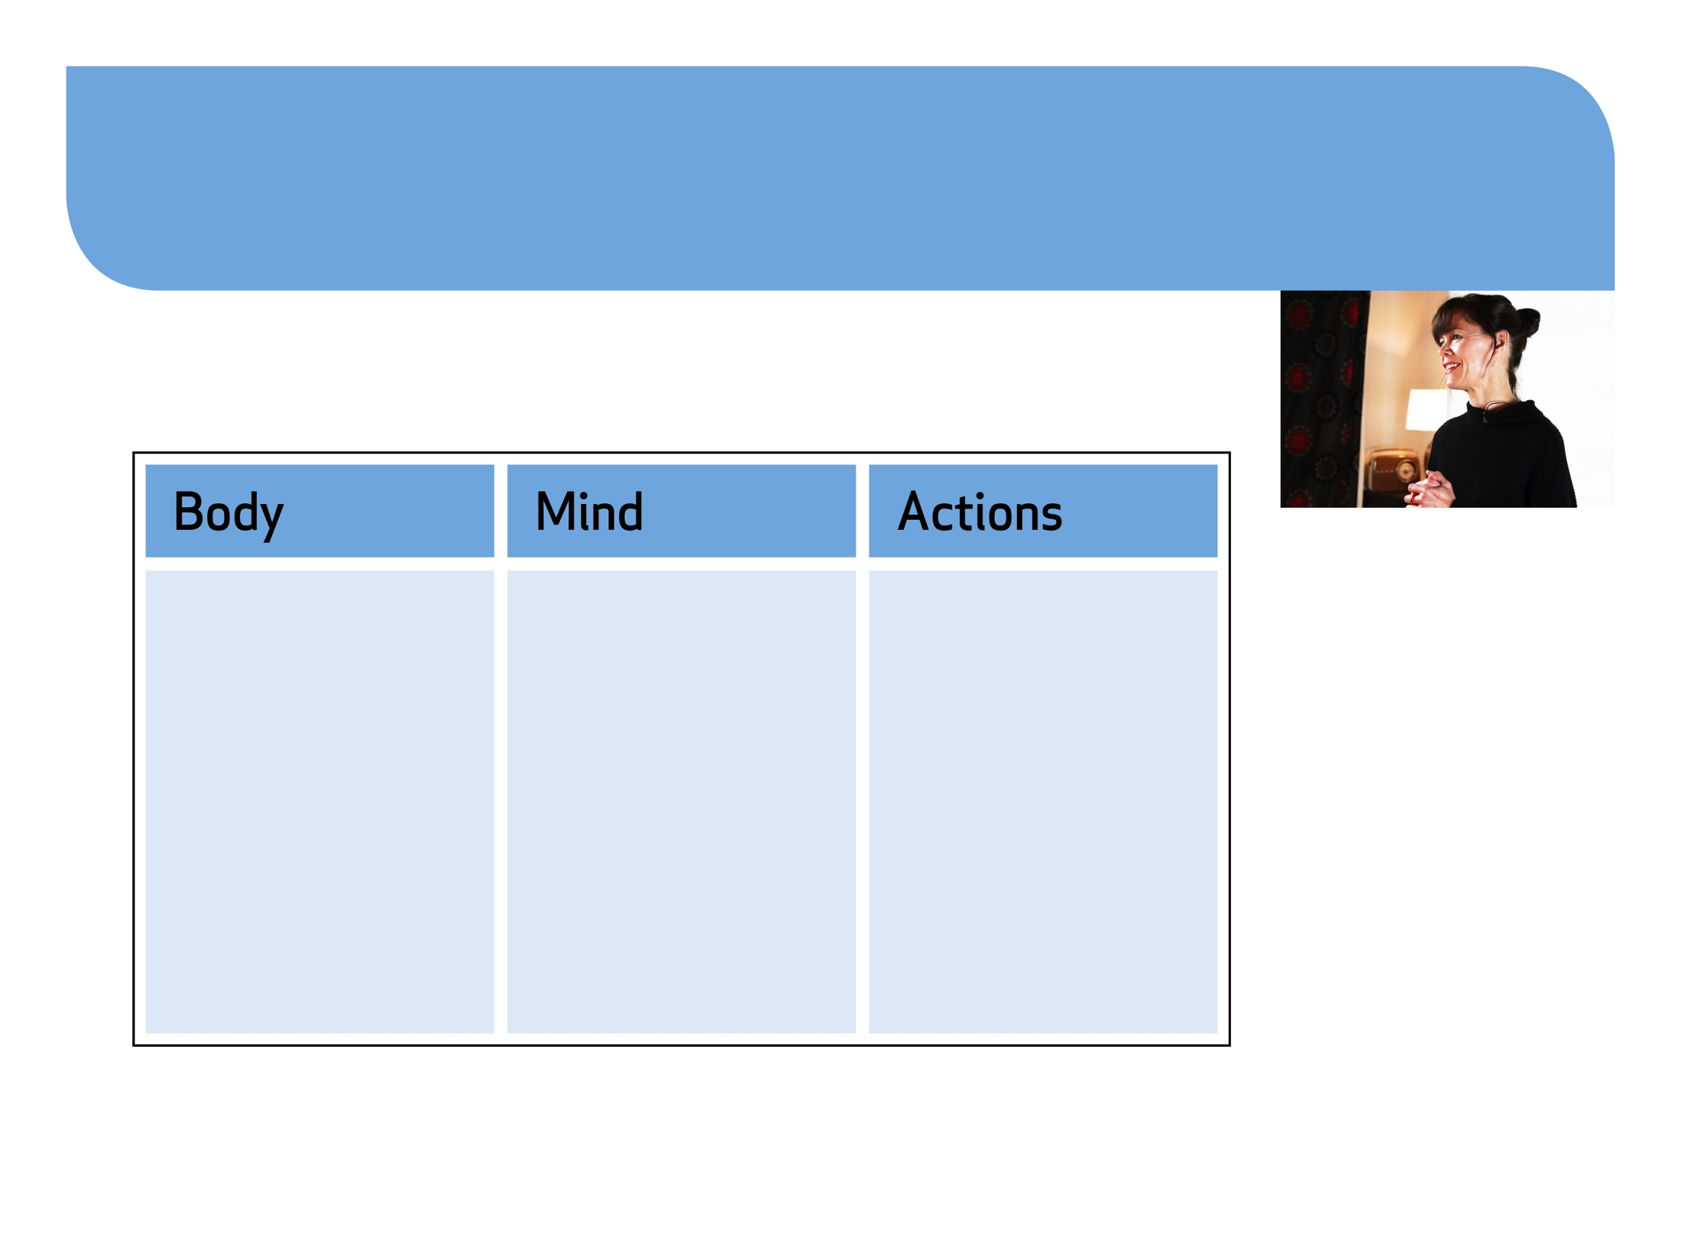
Video 1: Understanding Anorexia Fiona Flynn, Youth Development Officer at Bodywhys
Consider how Anorexia could affect:
Watch the video
#MoreThanASelfie Programme © Bodywhys 2020
www.bodywhys.ie

Slide 10
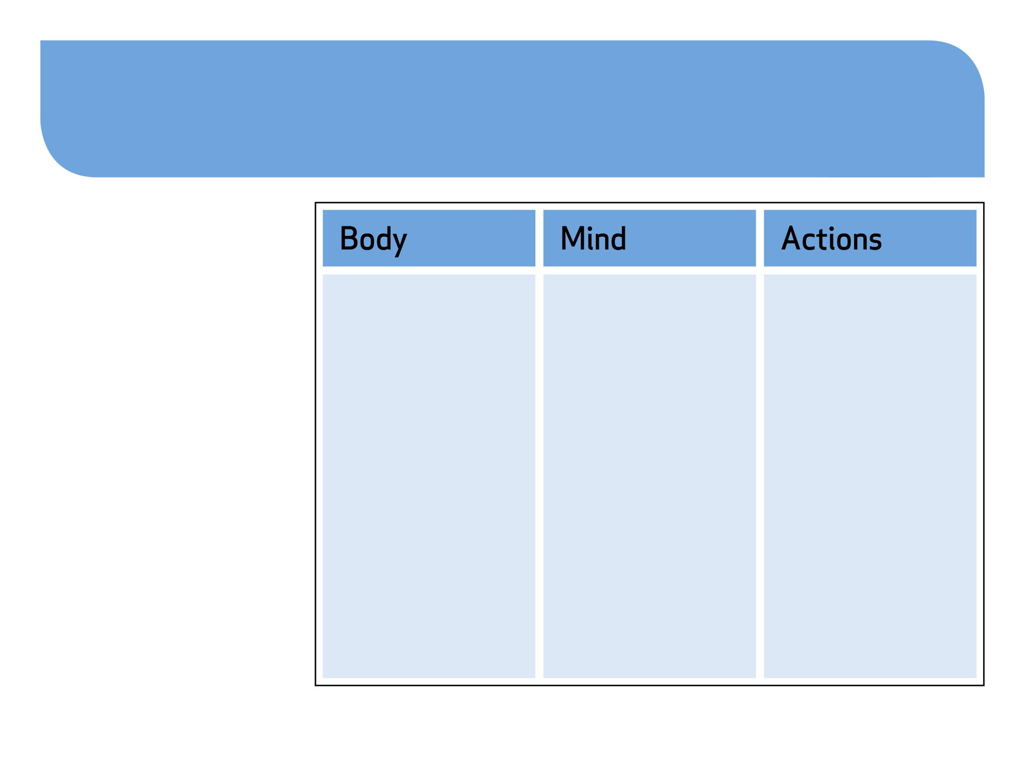
Anorexia can cause:
Severe weight loss
Death through organ failure
Osteoporosis
Hormonal disruption and infertility
Feel very cold. Growth of fine, downy hair on body to retain heat
Unable to concentrate
Obsessive thoughts about food weight and exercise
Self hatred and very negative thoughts about self
Feeling lonely and isolated
Personality changes
The person spends more time on their own
Obsessive behaviours around food and exercise
#MoreThanASelfie Programme © Bodywhys 2020
www.bodywhys.ie

Slide 11
Video 2: Understanding Bulimia Fiona Flynn, Youth Development Officer at Bodywhys
Consider how Bulima could affect:
Watch the video
#MoreThanASelfie Programme © Bodywhys 2020
www.bodywhys.ie

Slide 12
Bulimia can cause:
Weight changes
Disruption to potassium levels from vomiting can cause death through heart failure even when the person is a healthy weight
Hormonal disruption and infertility
Vomiting causes damage to teeth, sore throats, swollen glands, mouth ulcers and digestive problems
Unable to concentrate
Obsessive thoughts about food, weight and exercise
Self hatred and very negative thoughts about self
Feeling lonely and isolated
Personality changes
Mood swings
The person spends more time on their own
Rushing to bathroom after meals
Excessive exercising
#MoreThanASelfie Programme © Bodywhys 2020
www.bodywhys.ie

Slide 13
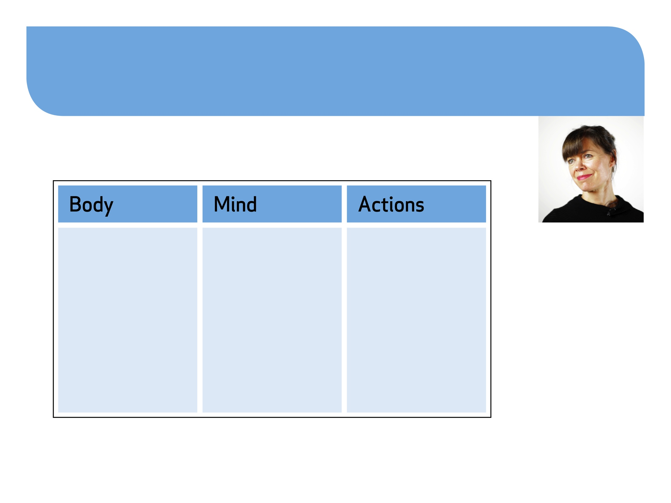
Video 3: Understanding Binge Eating Disorder Fiona Flynn, Youth Development Officer at Bodywhys
Consider how Binge Eating Disorder could affect:
Watch the video
#MoreThanASelfie Programme © Bodywhys 2020
www.bodywhys.ie

Slide 14
Binge Eating Disorder can cause:
Weight gain which may lead to a person becoming overweight or obese
Heart disease
High cholesterol
Diabetes
Hormonal disruption and infertility
Death through organ failure
Self hatred and very negative thoughts about self
Shame over secret bingeing
Depression
Unable to concentrate
Feels very uncomfortable eating in front of other people
Feeling lonely and isolated
The person spends more time on their own
Bingeing and eating in secret
Eat only small amounts in the company of other people
#MoreThanASelfie Programme © Bodywhys 2020
www.bodywhys.ie

Slide 15
Video 4: How do people develop eating disorders?
#MoreThanASelfie Programme © Bodywhys 2020
www.bodywhys.ie

Slide 16
An Eating Disorder affects your thinking and takes over every aspect of your life – making you doubt yourself and really holding you back from enjoying life
RECOVERY
THE EARLIER YOU GET HELP THE BETTER
#MoreThanASelfie Programme © Bodywhys 2020
www.bodywhys.ie

Slide 17
Full Recovery is Possible
A person can live a happy life and be happy with their body image after an eating disorder
#MoreThanASelfie Programme © Bodywhys 2020
www.bodywhys.ie

Slide 18
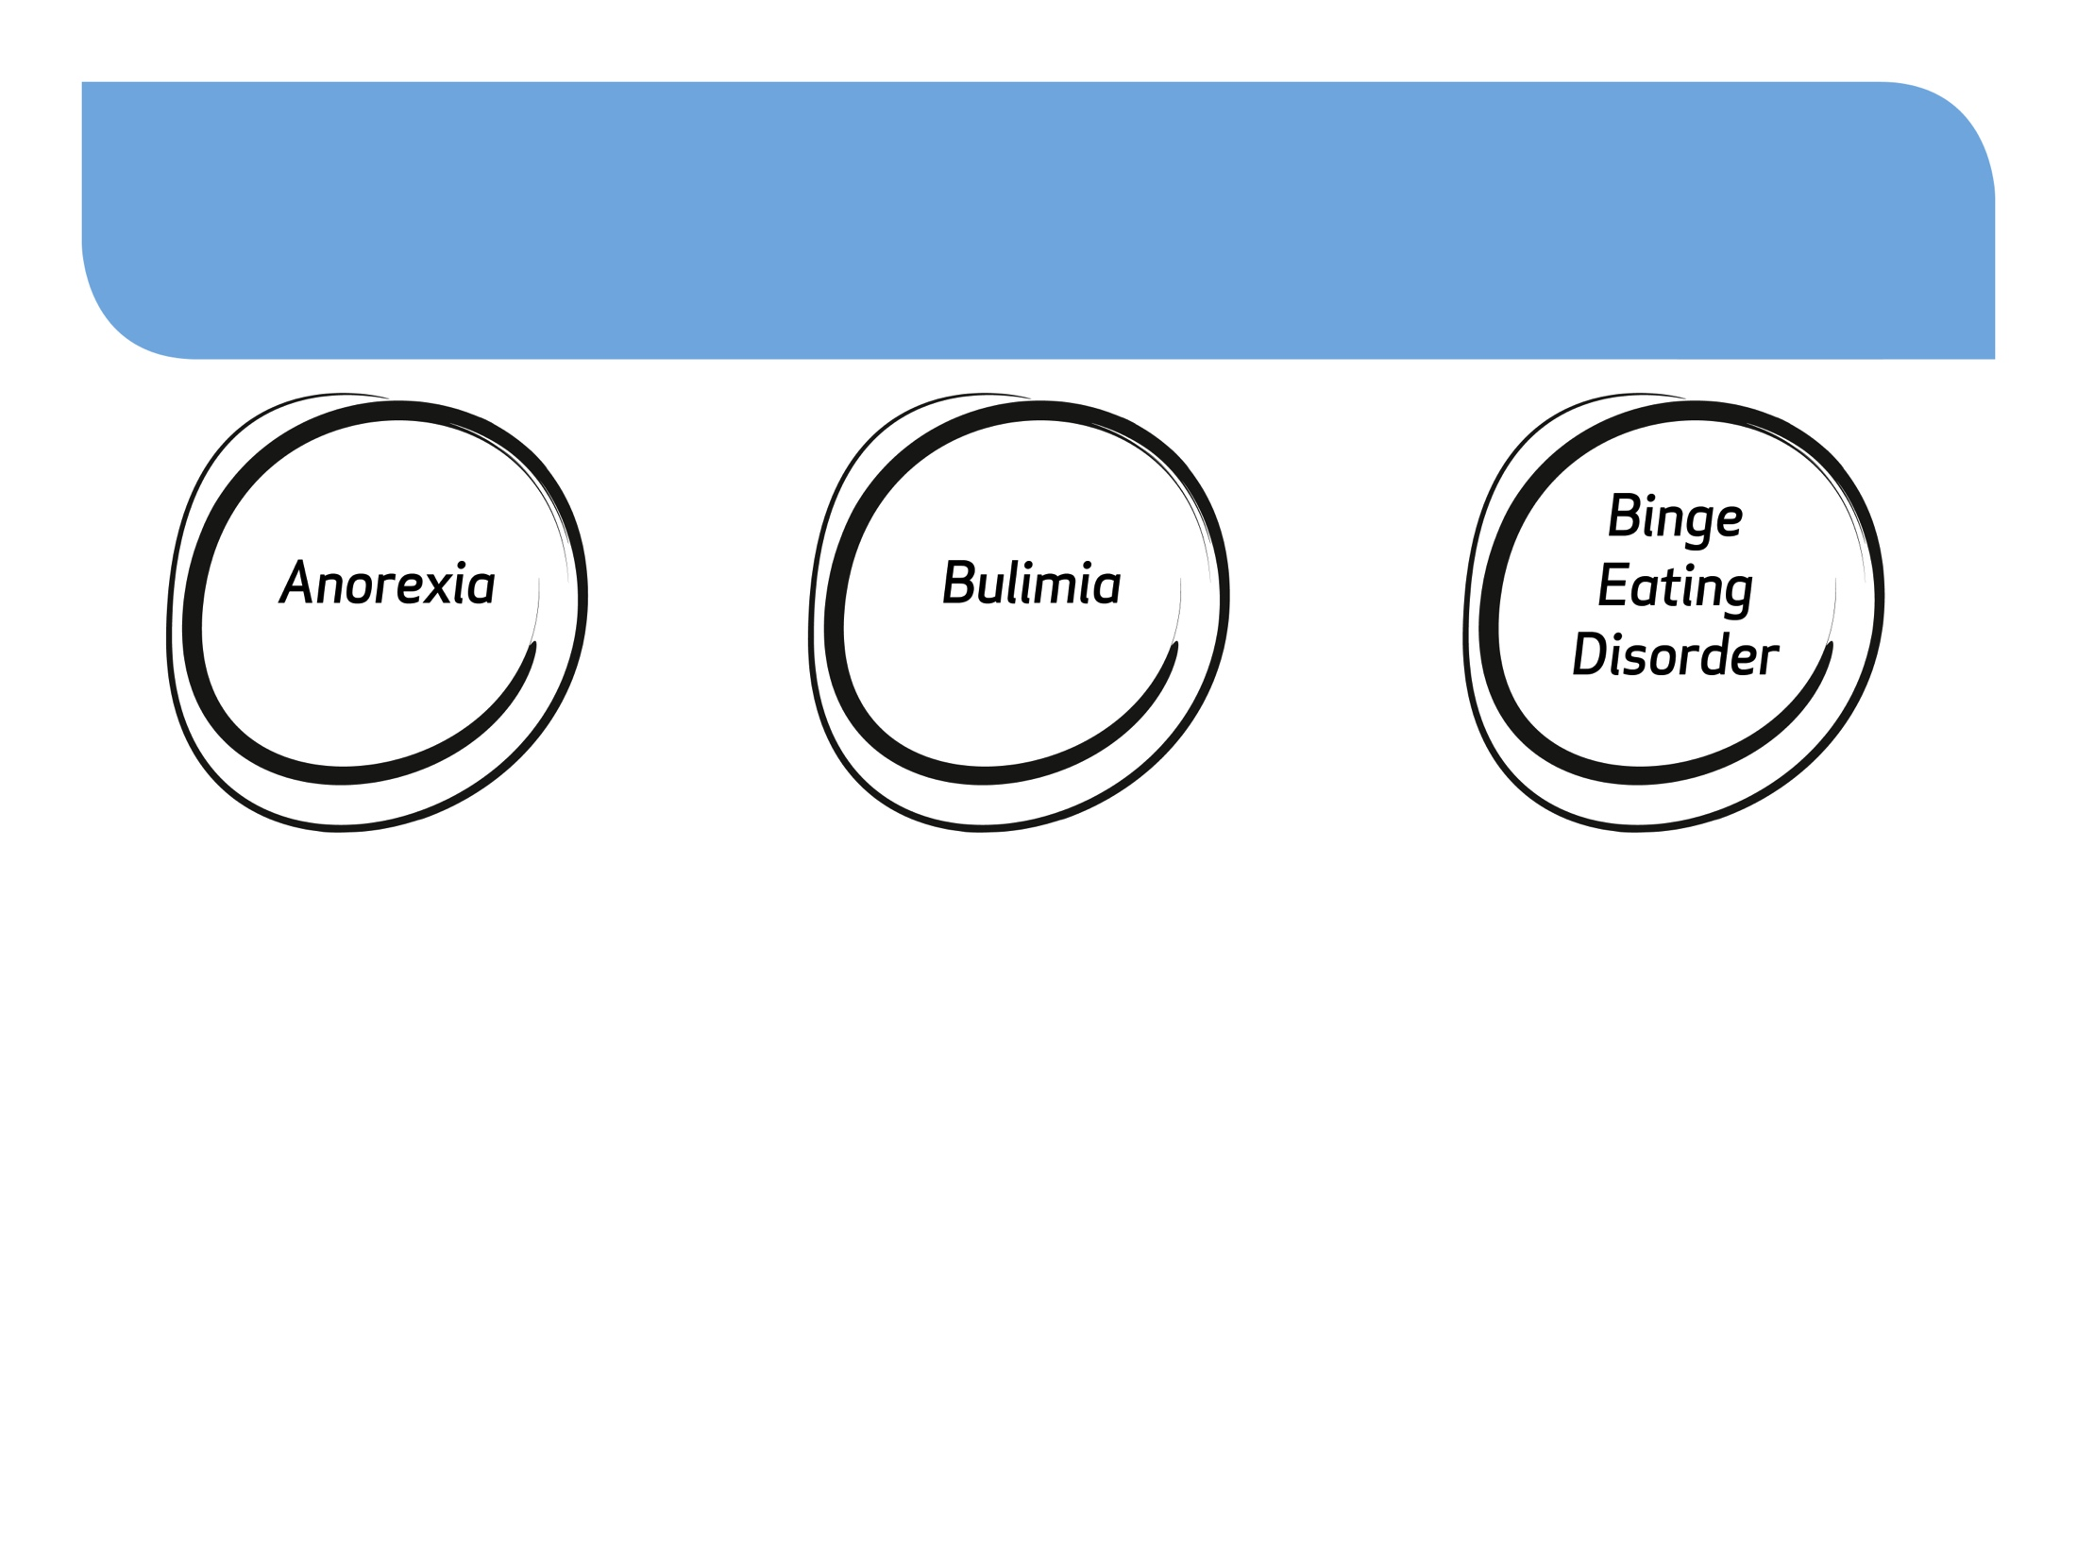
Summary Eating Disorders
People with Anorexia:
Eat as little as possible
Lose a lot of weight
Fear of putting on weight
Cannot see their body clearly
Excessive exercise
People with Bulima:
Binge eat
Make themselves sick
Over exercise
Binge and then starve
People with B.E.D:
Feel their eating is ‘out-of-control’
Eat so quickly during a binge they do not taste or enjoy food
Binge on large amounts of food
Eat until uncomfortably full
Hide eating habits
If you are concerned that thoughts about food, weight or exercise are taking over your thinking or causing difficulty in your life, do not delay - seek help as soon as possible.
#MoreThanASelfie Programme © Bodywhys 2020
www.bodywhys.ie

Slide 19
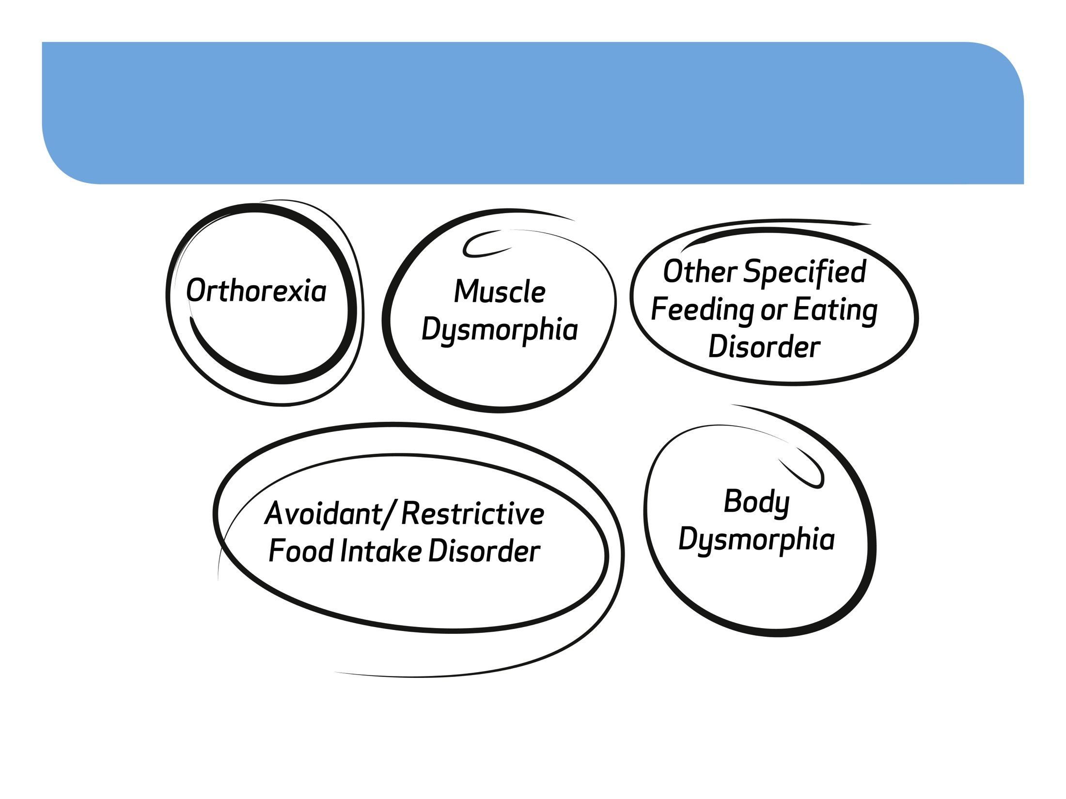
Other related disorders we might hear about in the media
For more information see: http://www.bodywhys.ie/aboutED/general-information/
#MoreThanASelfie Programme © Bodywhys 2020
www.bodywhys.ie

Slide 20
What causes an Eating Disorder?
Eating disorders occur as a result of a complex combination of factors including life experiences, biology, psychology with some common risk factors listed below.
Negative body image
Low self esteem
Bullying
Dieting
Training/exercising obsessively
Following media beauty ideals
#MoreThanASelfie Programme © Bodywhys 2020
www.bodywhys.ie

Slide 21
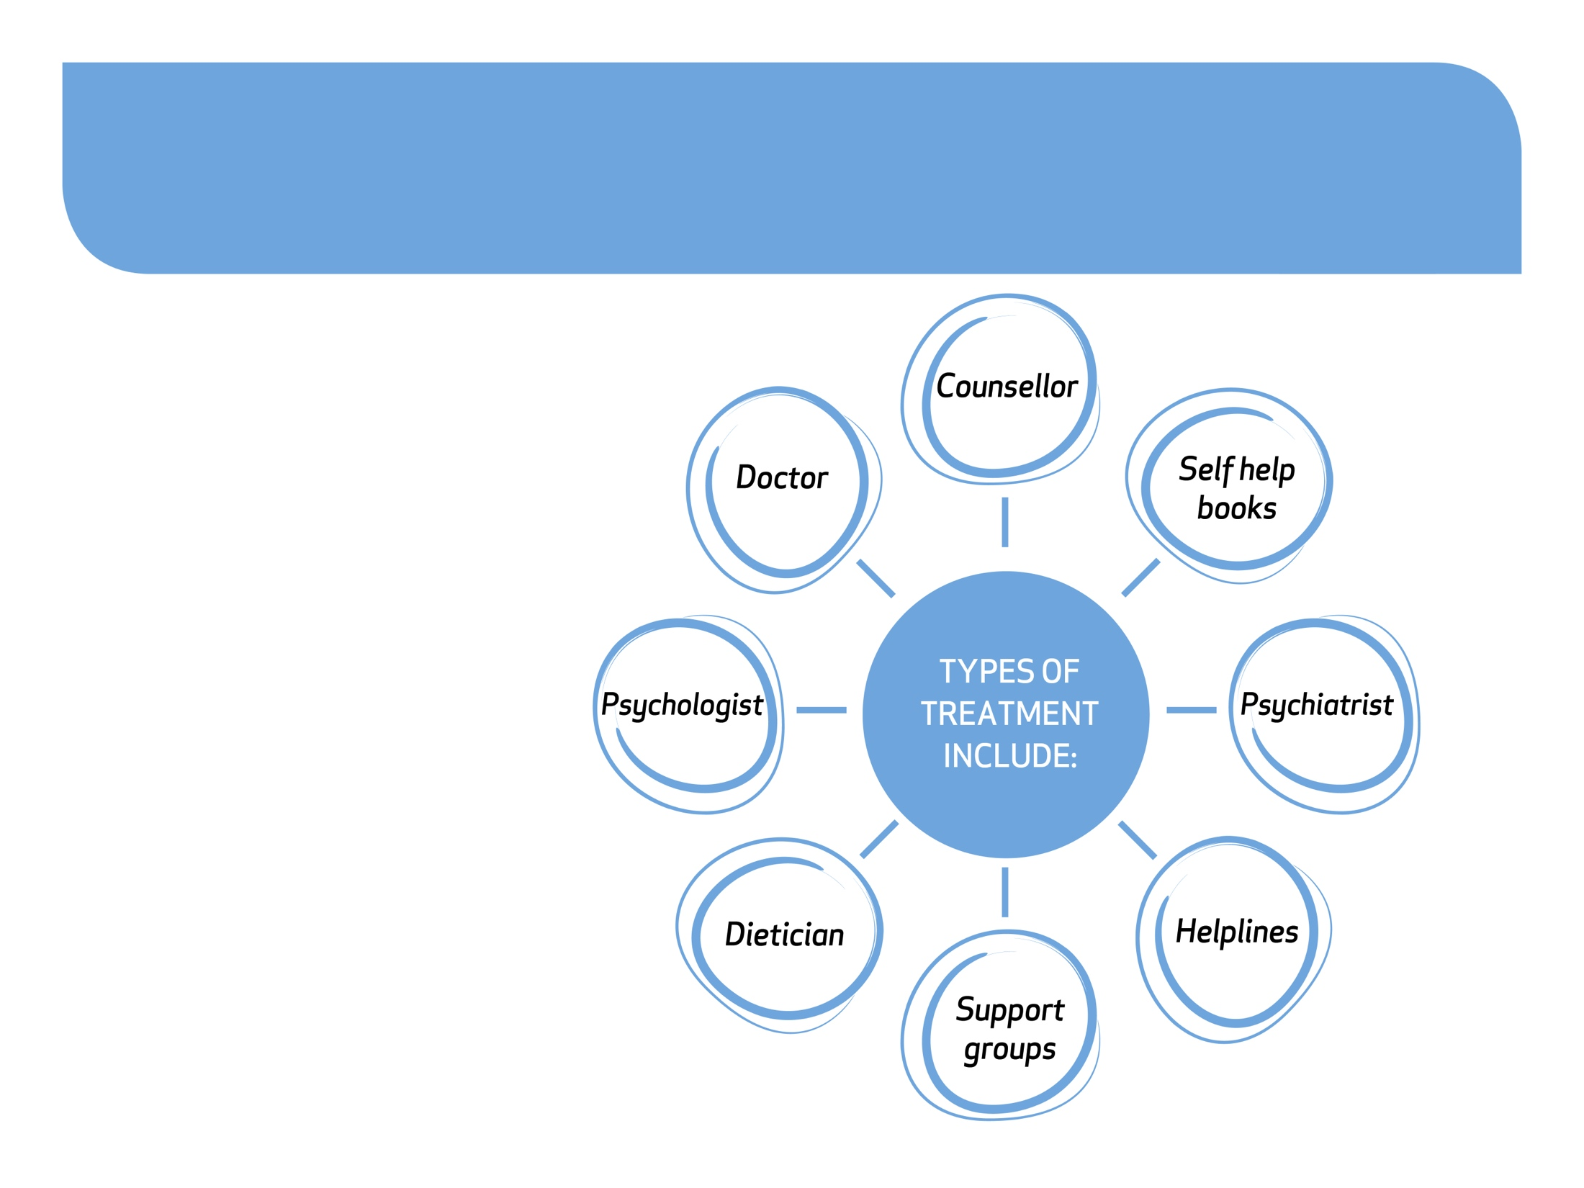
How people recover
Different types of treatment work for different people
#MoreThanASelfie Programme © Bodywhys 2020
www.bodywhys.ie

Slide 22
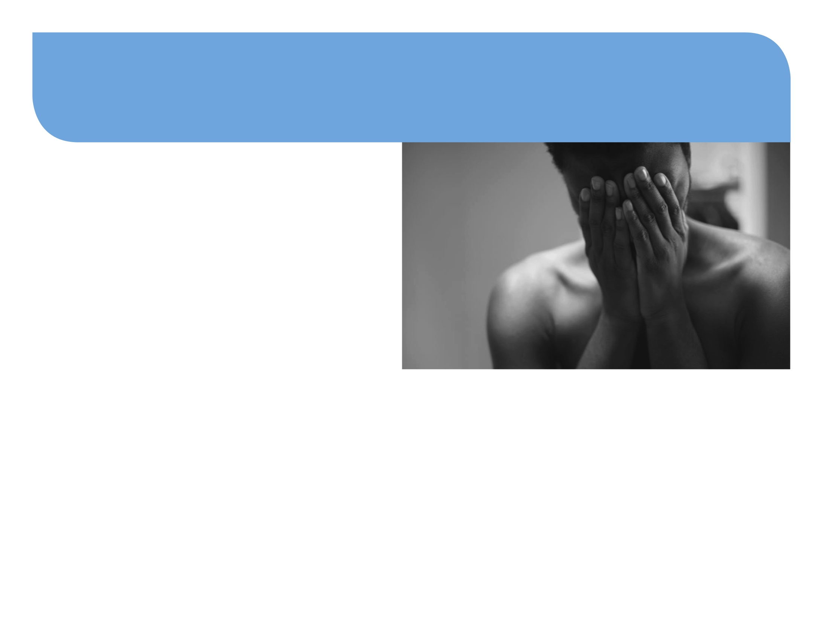
Choosing a Counsellor
Check that your counsellor is qualified and accredited.
See the Bodywhys directory of services list on www.bodywhys.ie
Choose a counsellor that you feel comfortable talking to. Not every counsellor will suit every person.
Don’t be discouraged if your counsellor doesn’t suit – be prepared to meet a few before settling on someone you feel comfortable with.
For more information see:
https://www.bodywhys.ie/treatment-pathway/psychotherapy-counselling
#MoreThanASelfie Programme © Bodywhys 2020
www.bodywhys.ie

Slide 23
What can you do if you’re worried about a friend?
#MoreThanASelfie Programme © Bodywhys 2020
www.bodywhys.ie

Slide 24
What to do if worried about a friend?
Get some information about eating disorders on www.bodywhys.ie
Talk to them someplace quiet where you won’t be disturbed.
Approach them gently. Listen to them. Let them know you care.
Tell them why you are concerned and what you have noticed.
Let them know they can get better and you want to help them.
#MoreThanASelfie Programme © Bodywhys 2020
www.bodywhys.ie

Slide 25
What to do if worried about a friend?
Don’t be surprised if they say they are fine and deny a problem.
Encourage them to seek help and ell someone who can help.
Although your friend may initially be angry with you if you tell an adult, it may be the first step in getting them the support and help they need.
Don't change your own eating habits or routines.
REMEMBER TO GET SOME SUPPORT FOR YOURSELF TOO. Supporting a friend who has an eating disorder can also be very stressful for you.
#MoreThanASelfie Programme © Bodywhys 2020
www.bodywhys.ie

Slide 26
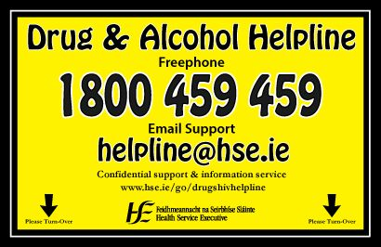
Supports for tough times: Remember no matter what your concern, there is always someone who can help ☺
#MoreThanASelfie Programme © Bodywhys 2020
www.bodywhys.ie

Slide 27
Visit www.bodywhys.ie for more information & resources
#MoreThanASelfie Programme © Bodywhys 2020
www.bodywhys.ie

