Slide 1
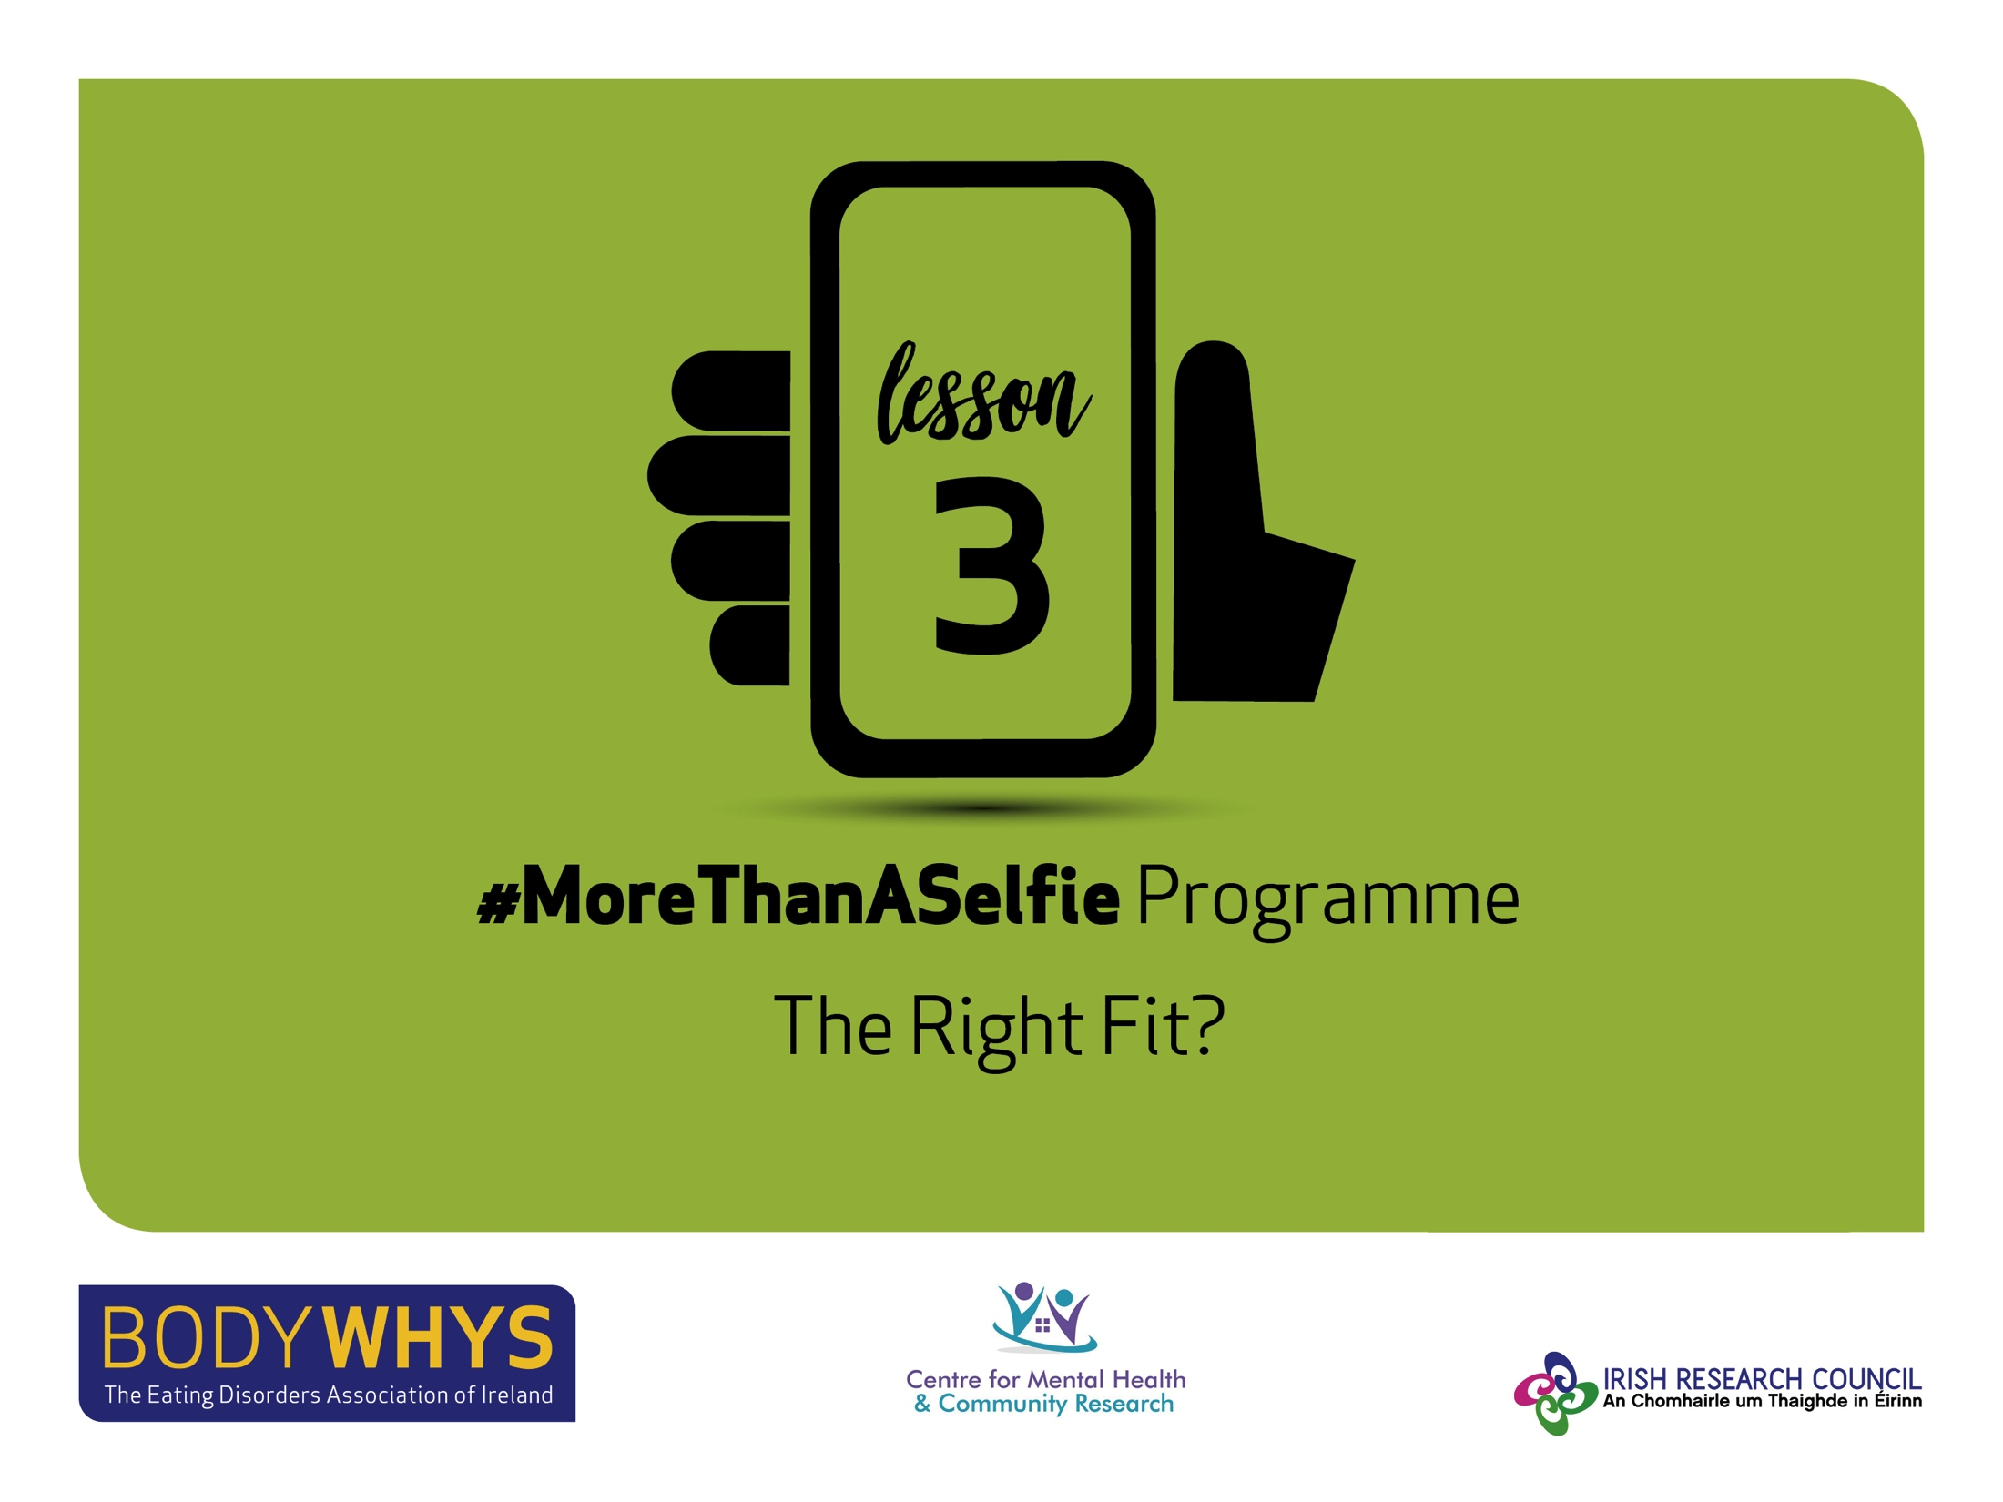
#MoreThanASelfie Programme © Bodywhys 2020
www.bodywhys.ie
#MoreThanASelfie Programme © Bodywhys 2020
www.bodywhys.ie

Slide 2
The right fit?
Sometimes people think that by trying to be more like other people they will fit in and feel better.
#MoreThanASelfie Programme © Bodywhys 2020
www.bodywhys.ie

Slide 3
Video 1: The right fit?
This video is about trying to fit in. Each time the students change a part of themselves to fit in they get a jigsaw piece. They think that by changing themselves to fit in they will be liked more.
They are all racing to change themselves and fill
their jigsaw so they feel more comfortable
and don’t stand out.
Watch the video
#MoreThanASelfie Programme © Bodywhys 2020
www.bodywhys.ie

Slide 4
Trying to fit in
Why do you think the people in the video did not look happy after getting all the jigsaw pieces?
#MoreThanASelfie Programme © Bodywhys 2020
www.bodywhys.ie

Slide 5
Trying to fit in
Do you think it is a good idea to change yourself to fit in?
Why? Why not?
#MoreThanASelfie Programme © Bodywhys 2020
www.bodywhys.ie

Slide 6
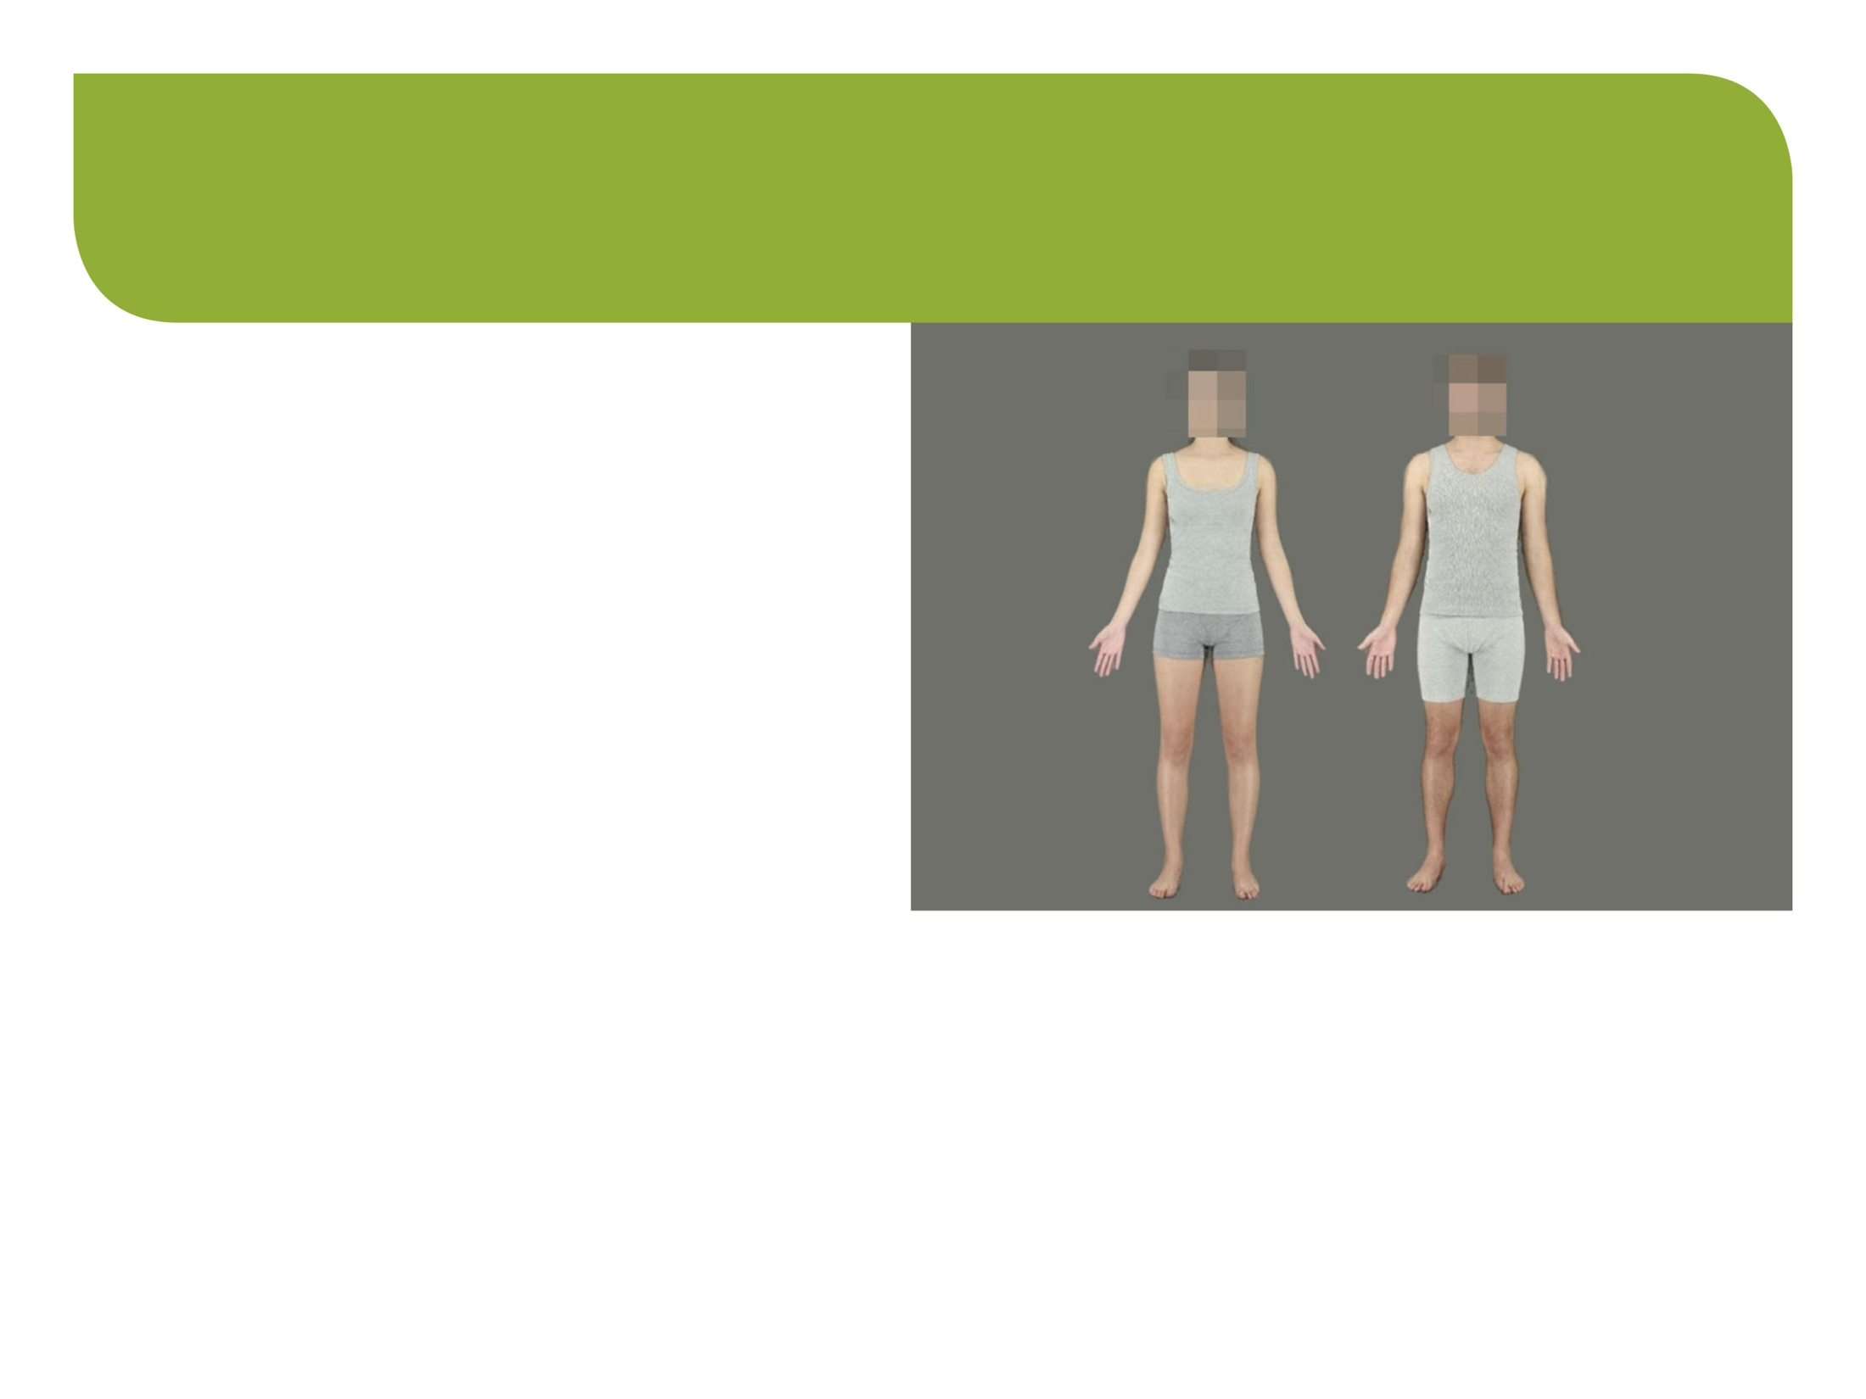
Pressure on Body Image
What were the pressures on body image we saw in
the video?
#MoreThanASelfie Programme © Bodywhys 2020
www.bodywhys.ie

Slide 7
How can you support each other?
How can we lessen pressure on friends in our conversations:
about the media, how people look, dieting, protein, fashion or make up?
How can you lessen pressure on friends to post or be online?
#MoreThanASelfie Programme © Bodywhys 2020
www.bodywhys.ie

Slide 8
Just Be Yourself
Reminder:
Go back to the
5 things you would like to try
Have you tried any yet?
What could you do...
This Week? This Month? In the next 6 Months?
NOTE TO SELF!
Set a reminder…
in your diary or someplace you’ll notice it
#MoreThanASelfie Programme © Bodywhys 2020
www.bodywhys.ie

Slide 9
Self Talk
What is Self Talk?
Does everyone have self talk?
#MoreThanASelfie Programme © Bodywhys 2020
www.bodywhys.ie

Slide 10
Video 2: Self Talk
Fiona Flynn, Youth Development Officer at Bodywhys
Watch the video
#MoreThanASelfie Programme © Bodywhys 2020
www.bodywhys.ie

Slide 11
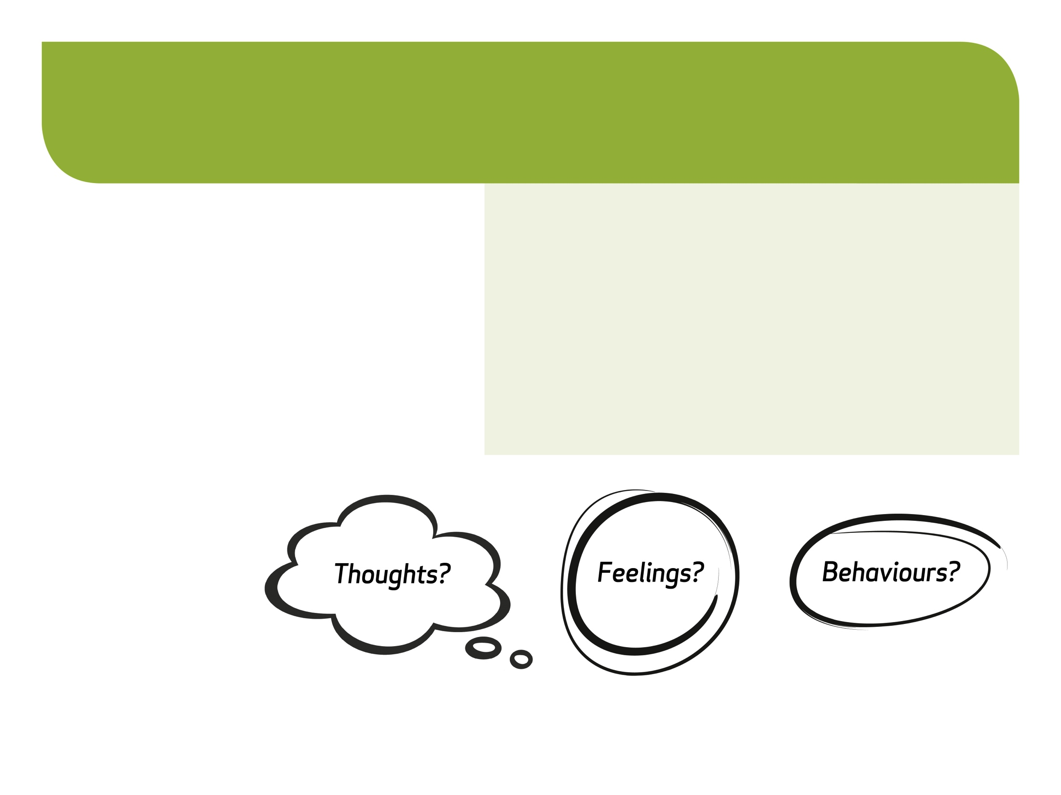
Self Talk - What we think/say to ourselves in our minds
Scenario 1: You are just running out the door to a night out and catch a glimpse of yourself in the mirror as you leave and think to yourself “the state of me - I look awful”.
How could this self talk affect your…
#MoreThanASelfie Programme © Bodywhys 2020
www.bodywhys.ie

Slide 12
Self Talk – Everyone has Self Talk
Scenario 2: You have decided to learn the guitar. You go to your first lesson and find it is harder than you thought. You think/say to yourself “I knew I’d be no good at this – it’s pointless even trying”
How could this self talk affect your…
#MoreThanASelfie Programme © Bodywhys 2020
www.bodywhys.ie

Slide 13
Self Talk
Think about some of the things we say to ourselves in our own heads…
Would you say this to your best friend?
#MoreThanASelfie Programme © Bodywhys 2020
www.bodywhys.ie

Slide 14
The way you talk to yourself and how you think about things can have a direct effect on how you feel
Hardly anyone liked my social media post – nobody likes me
I don’t need people to like my posts in order for me to feel ok. Real friendship is not about the number of likes online – having a few friends who care about me is more important than likes online.
Not letting my mood be totally dependent on likes online. Comforted by the thought that social media is not representative of real life. Focused on the things
I enjoy doing in my own life.
Upset, lonely, hopeless
#MoreThanASelfie Programme © Bodywhys 2020
www.bodywhys.ie

Slide 15
Each group pick an example of a situation that would be difficult to deal with and fill it in on the chart below
#MoreThanASelfie Programme © Bodywhys 2020
www.bodywhys.ie

Slide 16
Things to think about before the next lesson ☺
Try and become more aware of what you are saying/thinking to yourself and see if you can change your self talk to be more positive. You can use the grid below to help change some of your self talk if you wish. Sometimes it’s easier to consider how you would advise a good friend if they were thinking this way.
#MoreThanASelfie Programme © Bodywhys 2020
www.bodywhys.ie

Slide 17
Body Image is only 1 part of who we are
Video 3: Change how you feel not how you look
Something to think about…
Watch the video
Think of 5 people you like spending time with – why do you like spending time with them?
#MoreThanASelfie Programme © Bodywhys 2020
www.bodywhys.ie

Slide 18
Look out for each other
All of us have ups and
downs but a smile or a friendly chat can really make a difference to somebody when they’re down
#MoreThanASelfie Programme © Bodywhys 2020
www.bodywhys.ie

Slide 19
Supports for tough times: Remember no matter what your concern, there is always someone who can help ☺
#MoreThanASelfie Programme © Bodywhys 2020
www.bodywhys.ie

Slide 20
Visit www.bodywhys.ie for more information & resources
#MoreThanASelfie Programme © Bodywhys 2020
www.bodywhys.ie

