Slide 1
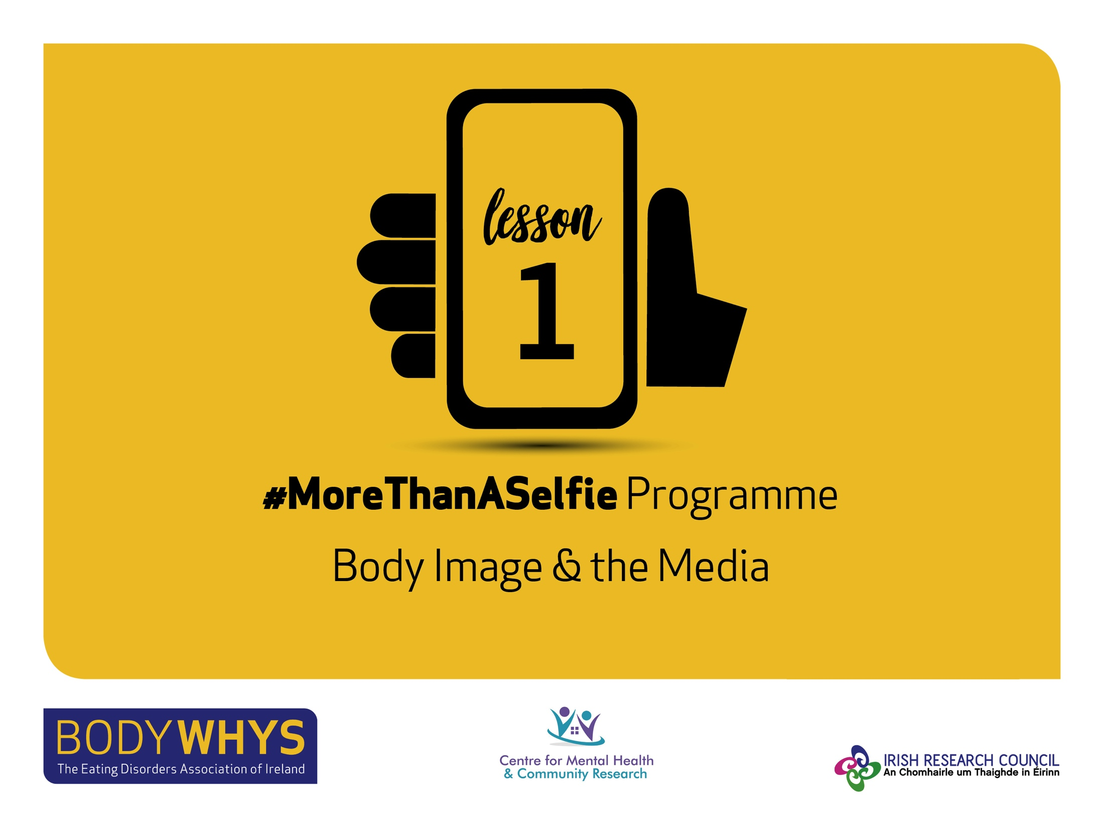
#MoreThanASelfie Programme © Bodywhys 2020
www.bodywhys.ie

Slide 2
What is Body Image?
#MoreThanASelfie Programme © Bodywhys 2020
www.bodywhys.ie

Slide 3
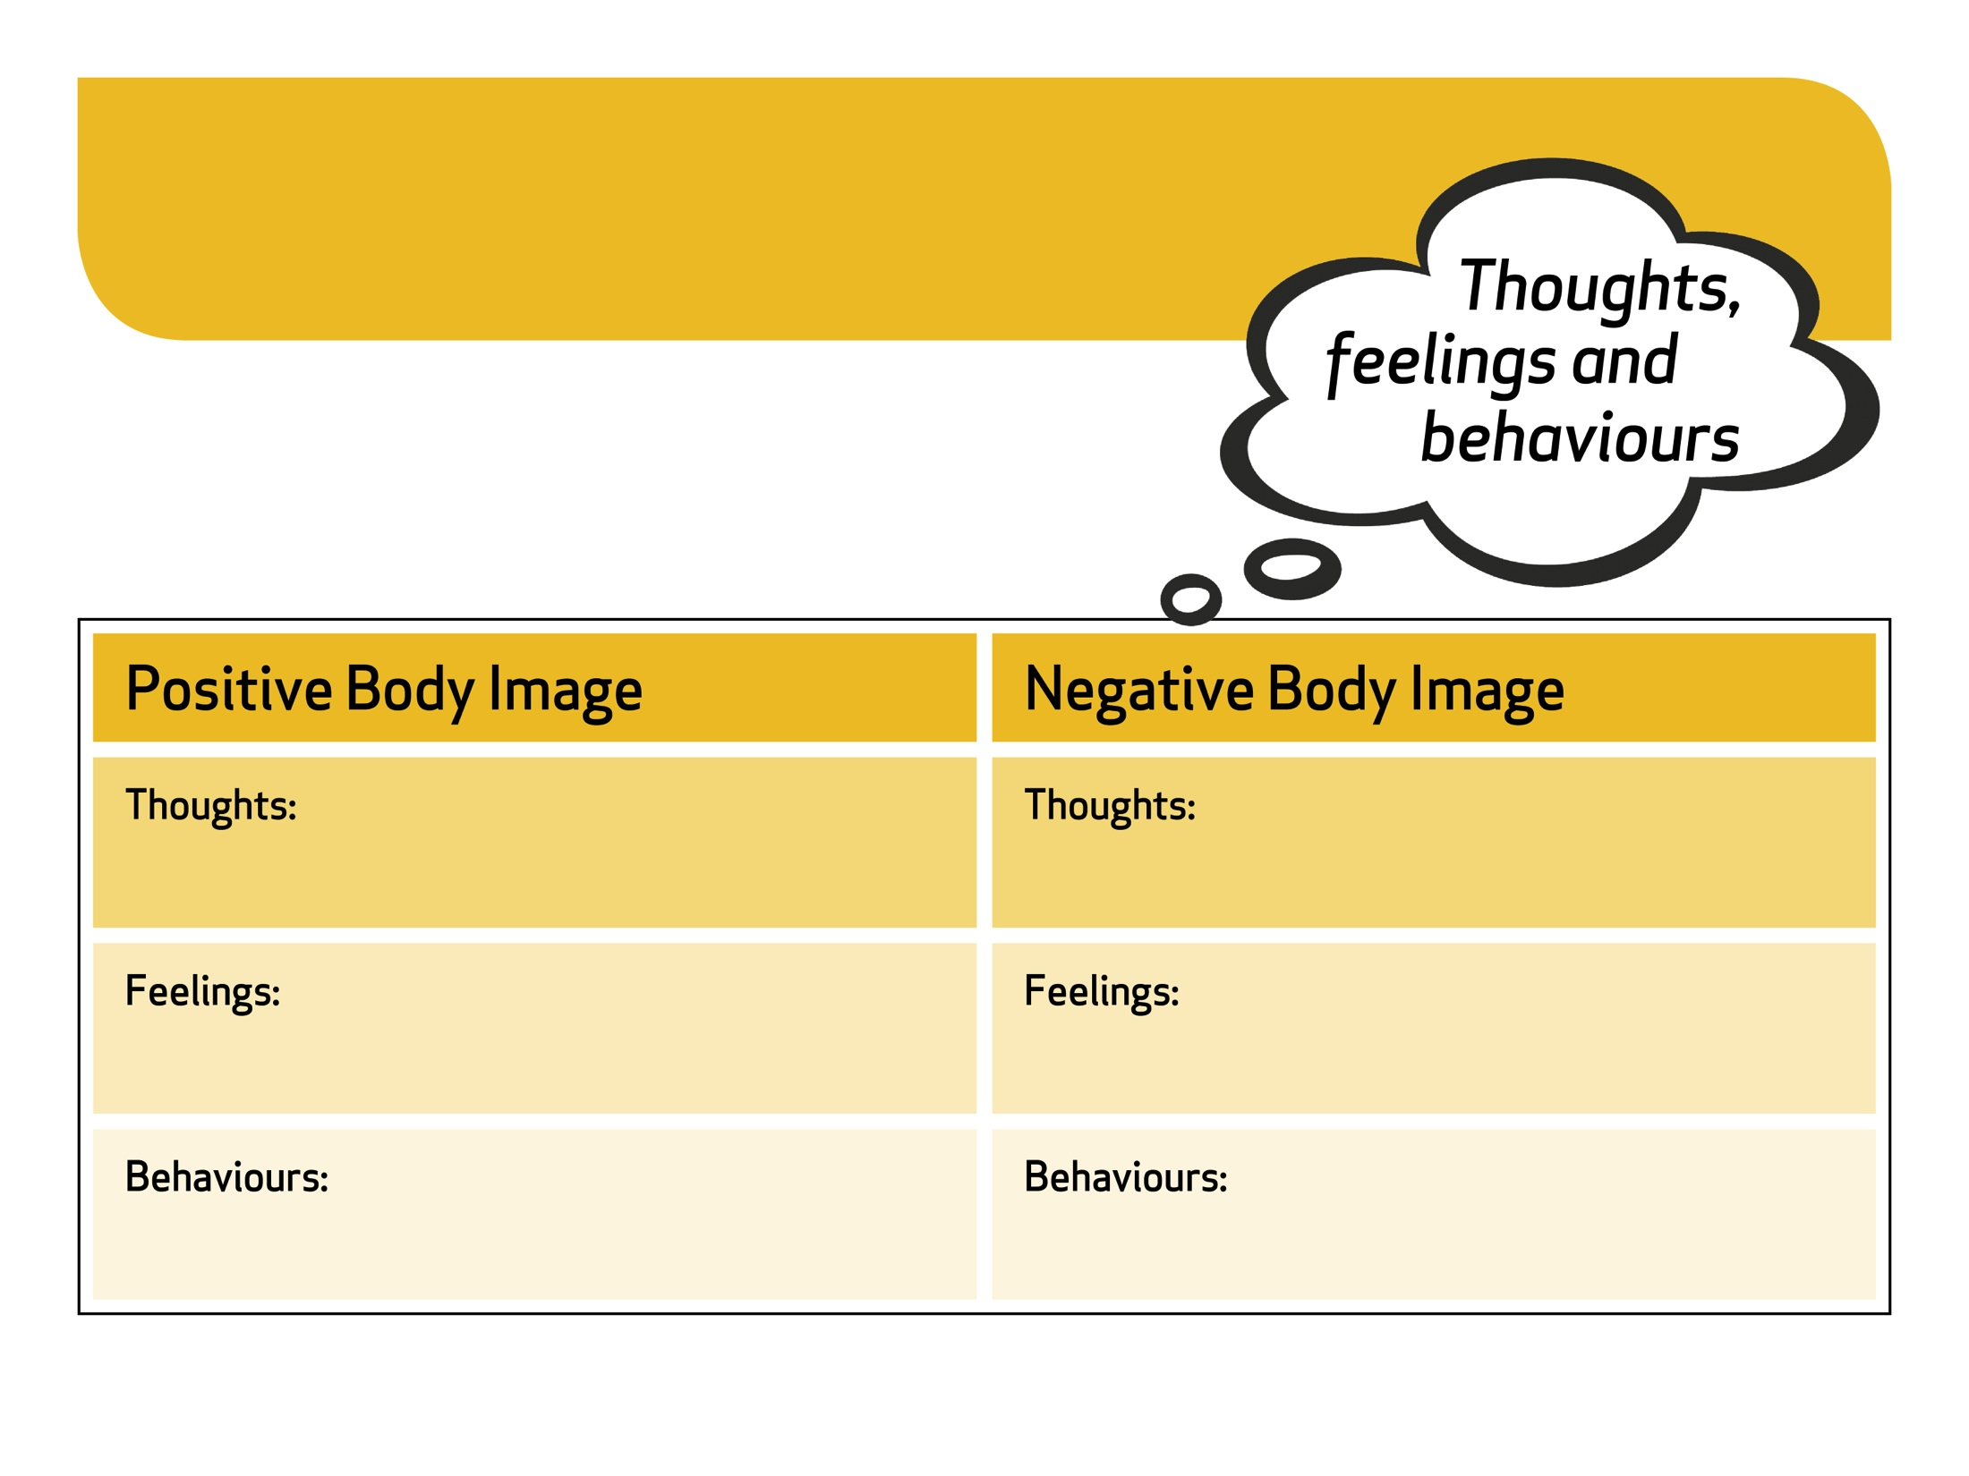
How does body image affect your…
#MoreThanASelfie Programme © Bodywhys 2020
www.bodywhys.ie

Slide 4
Even celebrities describe body image pressure…
#MoreThanASelfie Programme © Bodywhys 2020
www.bodywhys.ie

Slide 5
…and their advice ☺
#MoreThanASelfie Programme © Bodywhys 2020
www.bodywhys.ie

Slide 6
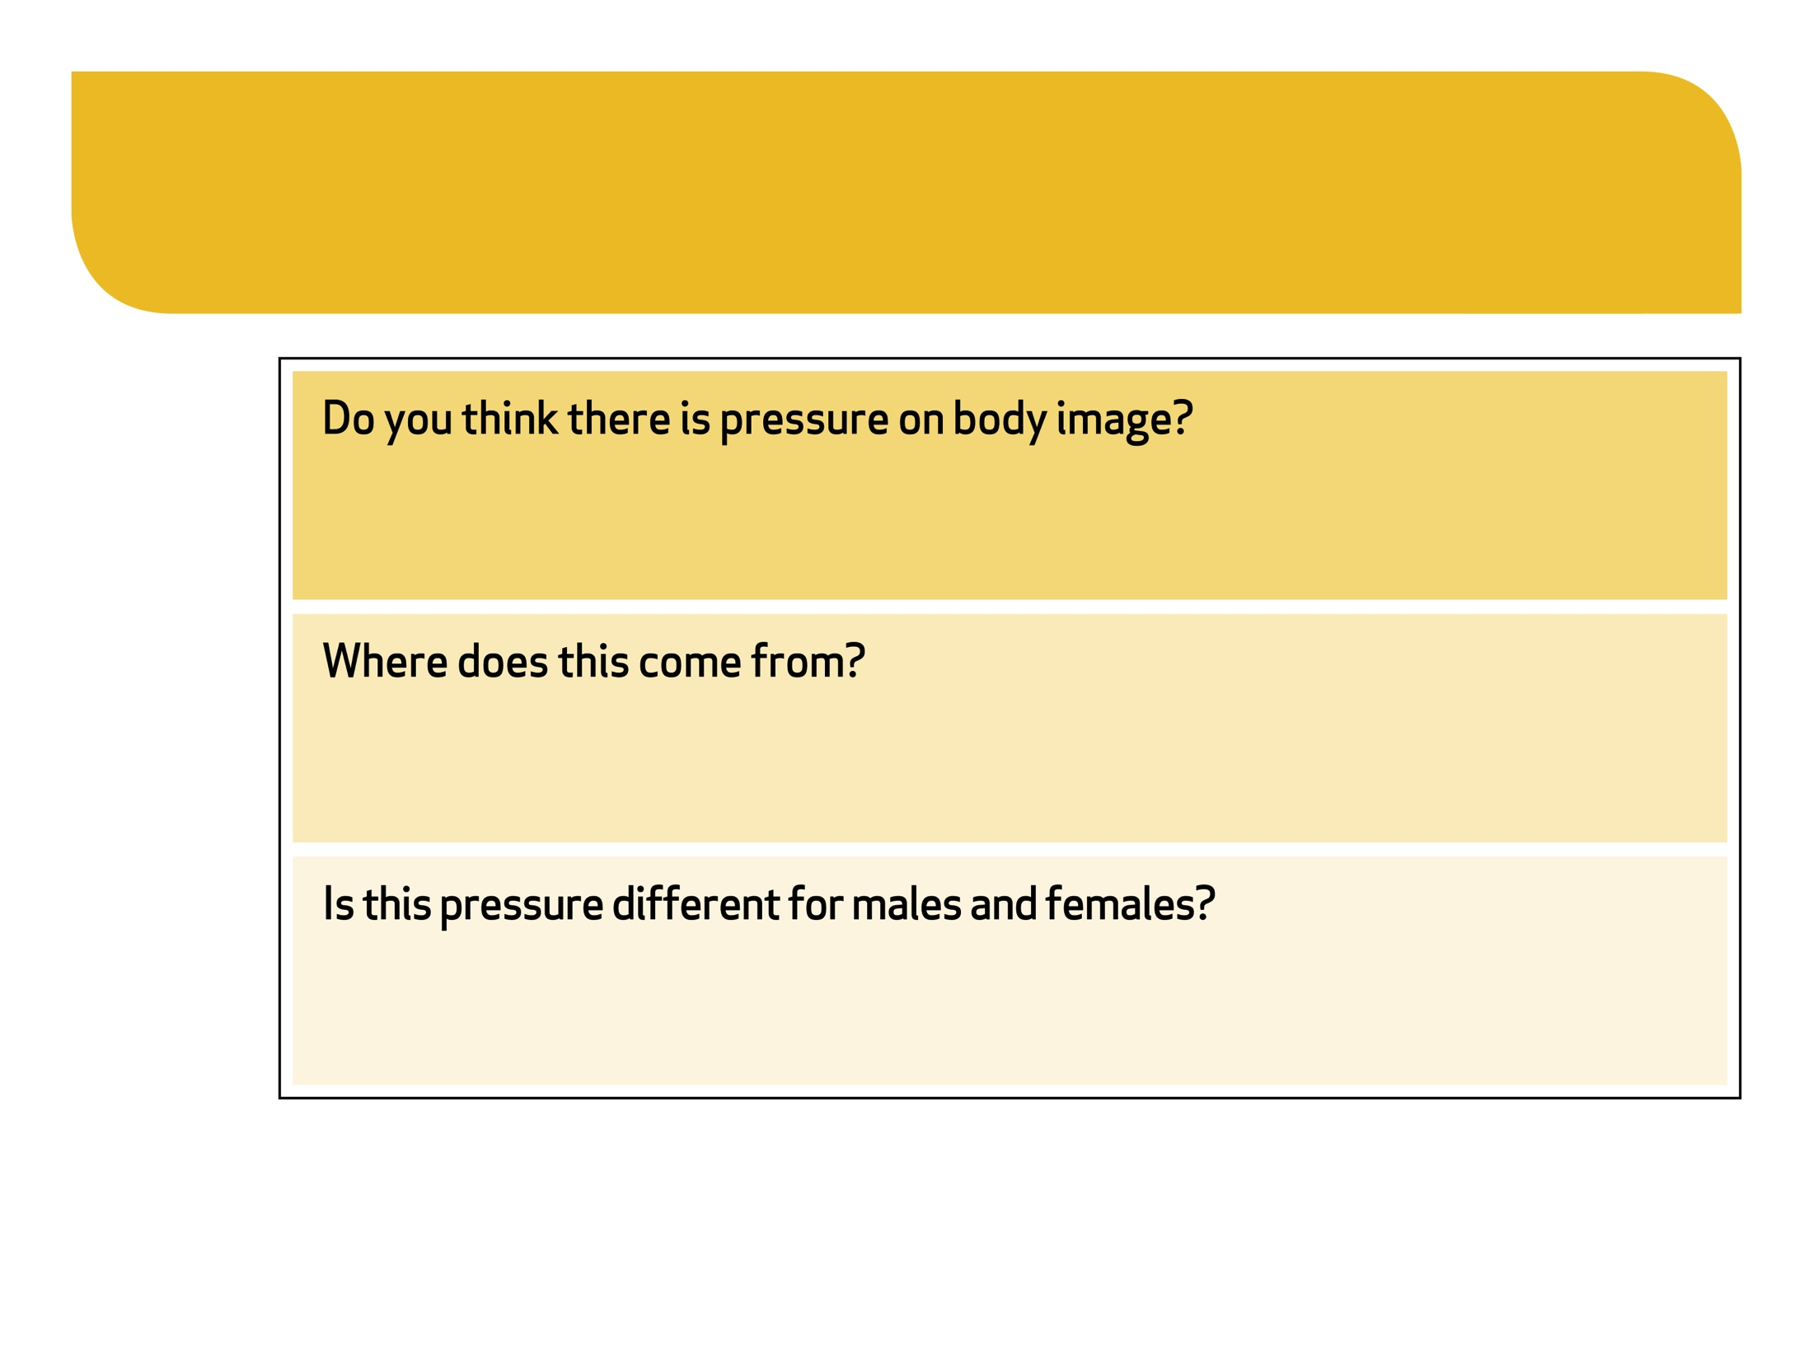
Body Image Pressure
#MoreThanASelfie Programme © Bodywhys 2020
www.bodywhys.ie

Slide 7
What do young people in Ireland think?
“72% of young people surveyed said that body image caused them difficulties in their life”
“What’s Wrecking Your Head?”
Survey of 2,500 young people
(Chambers et al, 2017)
#MoreThanASelfie Programme © Bodywhys 2020
www.bodywhys.ie

Slide 8
The influences on body image…
Young people describe social media as a big influence on body image.
#MoreThanASelfie Programme © Bodywhys 2020
www.bodywhys.ie

Slide 9
Social Media Myths
#MoreThanASelfie Programme © Bodywhys 2020
www.bodywhys.ie

Slide 10
Video 1: Are you living an Insta-lie?
Watch the video
#MoreThanASelfie Programme © Bodywhys 2020
www.bodywhys.ie

Slide 11
We spoke to group of young Irish guys who grew up in the public eye about body image and social media…
Who are they?
The Strypes band shot to success in 2010 with members age 13-15 at the time. They achieved worldwide fame and performed to packed audiences in Japan, South America, Australia and Europe. The band split in November 2018.
#MoreThanASelfie Programme © Bodywhys 2020
www.bodywhys.ie

Slide 12
Video 2: Social Media Myths
Watch the video
#MoreThanASelfie Programme © Bodywhys 2020
www.bodywhys.ie

Slide 13
What preparation may have gone into creating the photo used in the advertisement below?
#MoreThanASelfie Programme © Bodywhys 2020
www.bodywhys.ie

Slide 14
Video 3: Notice the media beauty techniques
Watch the video
#MoreThanASelfie Programme © Bodywhys 2020
www.bodywhys.ie

Slide 15
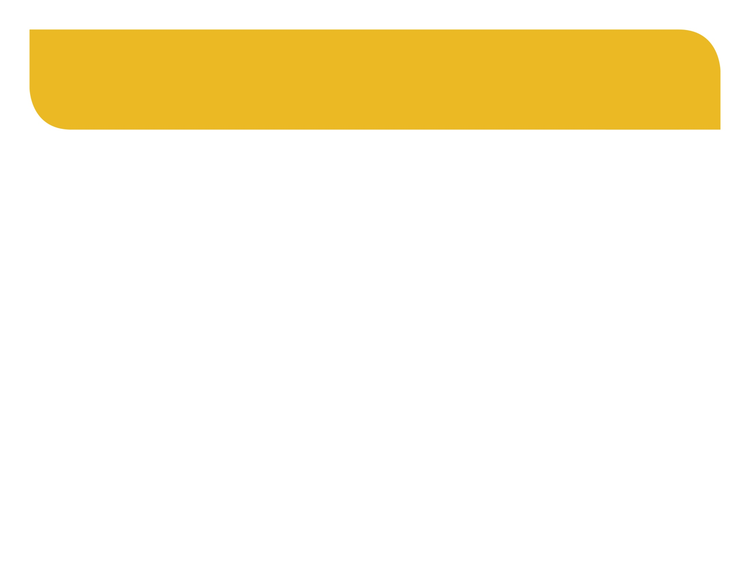
Real or Marketing?
We know that the advertisements we see on billboards have been professionally styled and edited, but what about online?
Can celebrities make money from advertising on social media? How?
#MoreThanASelfie Programme © Bodywhys 2020
www.bodywhys.ie

Slide 16
Video 4: Real or Marketing?
Watch the video
#MoreThanASelfie Programme © Bodywhys 2020
www.bodywhys.ie

Slide 17
Real or Marketing?
#MoreThanASelfie Programme © Bodywhys 2020
www.bodywhys.ie

Slide 18
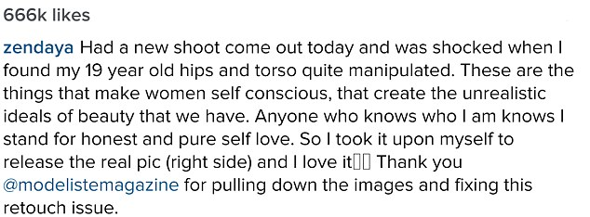
‘Spot the differences’ in the before and after images:
#MoreThanASelfie Programme © Bodywhys 2020
www.bodywhys.ie

Slide 19
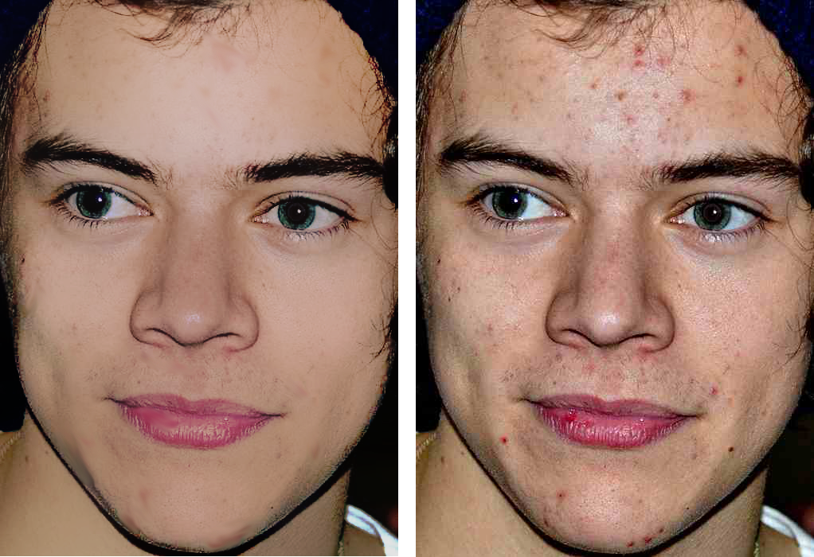
Every day we see photos of celebrities who have had their body shape, skin and hair photo-shopped to look like perfection.
Try and notice the images you see this week and remember how these flawless images are created. They are not real.
#MoreThanASelfie Programme © Bodywhys 2020
www.bodywhys.ie

Slide 20
Things to think about before the next lesson ☺
#MoreThanASelfie Programme © Bodywhys 2020
www.bodywhys.ie

Slide 21
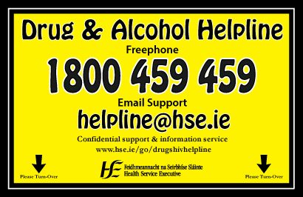
Supports for tough times: Remember no matter what your concern, there is always someone who can help ☺
#MoreThanASelfie Programme © Bodywhys 2020
www.bodywhys.ie

Slide 22
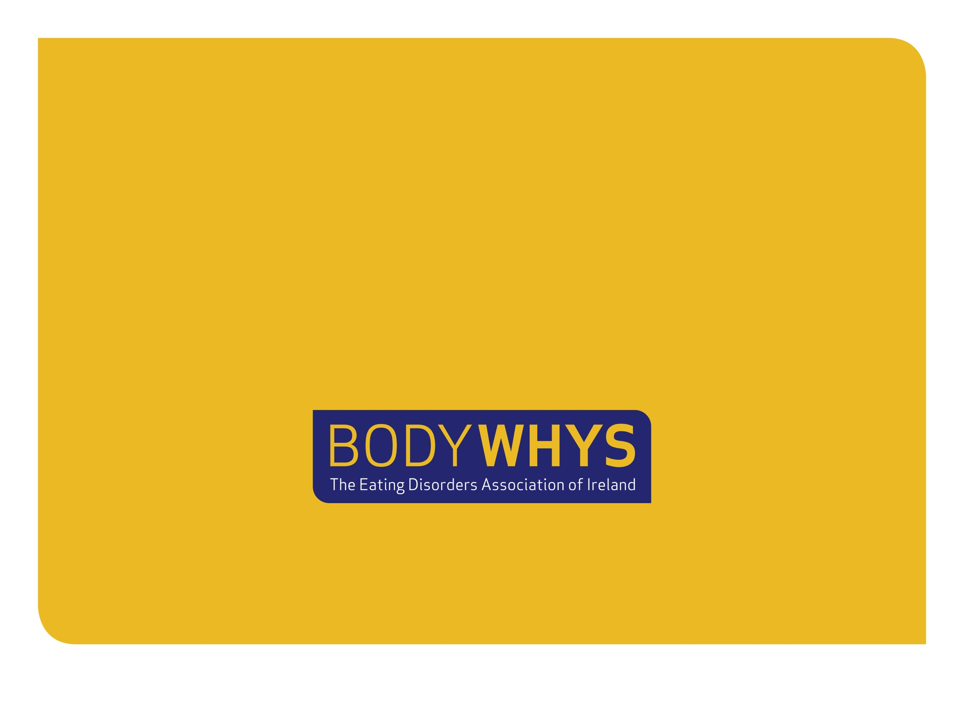
Visit www.bodywhys.ie for more information
#MoreThanASelfie Programme © Bodywhys 2020
www.bodywhys.ie

